Slide 1
BigData Spark Hands-On 3 [part 1] Spark on k8s Podman Install
arnaud.nauwynck@gmail.com
Esilv 2024

Slide 2
Outline
Install podman (~Docker) on local Windows/Mac/Linux
Install Kubernetes Cluster "Kind" (=K8s in Docker)
Install Kubernetes Tools: k9s, helm, aliases
Install spark-operator for K8s using Helm + check/fixes
(Optional) Launch spark-shell on Docker, in mode "--master local[*]"
(Optional) Launch spark with "spark-submit --master k8s://localhost:port"
Launch spark with "kubectl apply -f file.yaml"
(Optional... and backup if local install fails) Using Azure Kubernetes
part 2/2

Slide 3
Pre-Requisites: install K8s (even on Windows, with podman + Kind)

Slide 4

For Windows, Install a modern "Terminal" (do not use "cmd", nor "Power Shell)
winget install Microsoft.WindowsTerminal

Slide 5
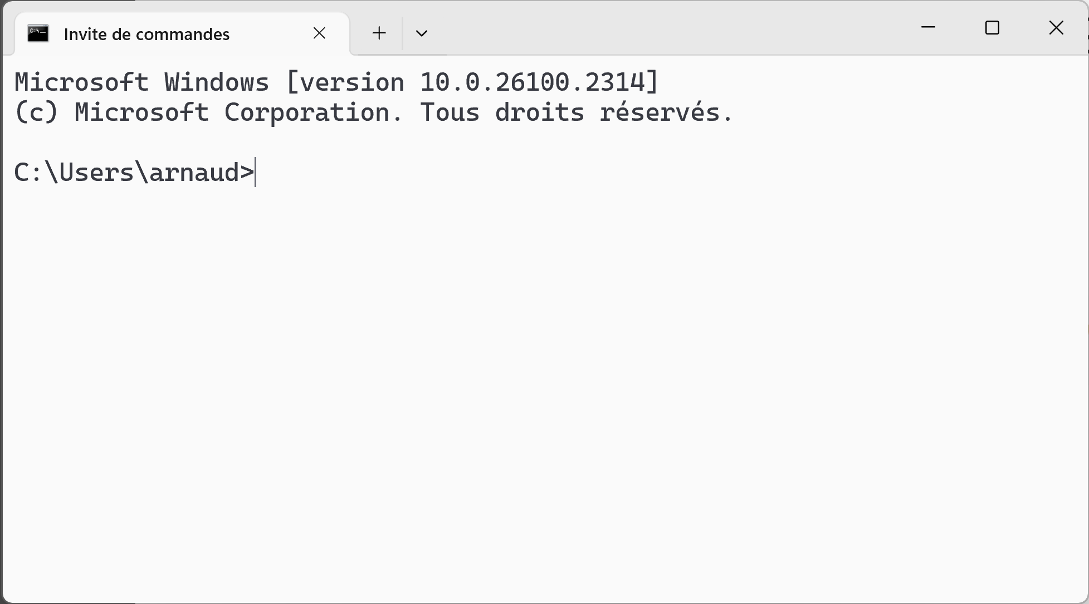
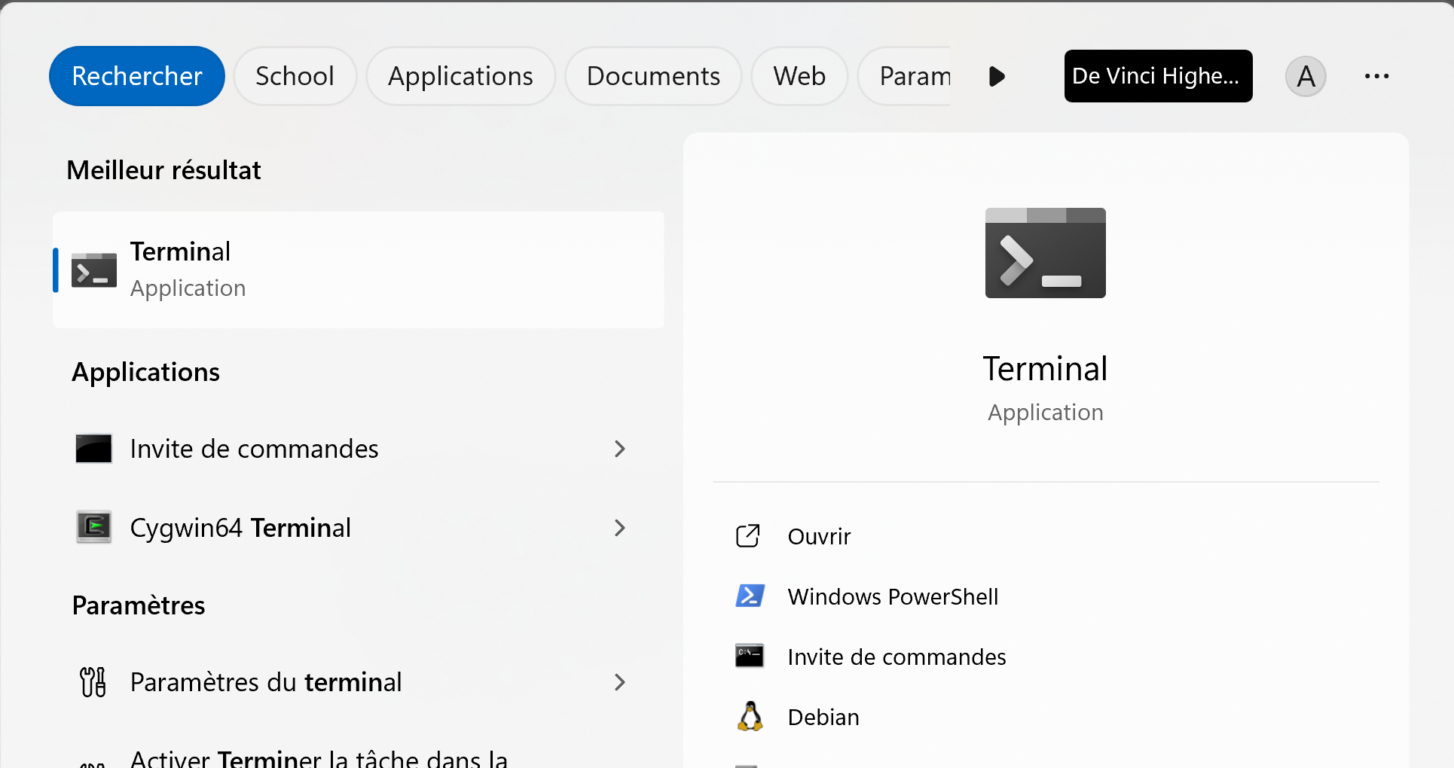
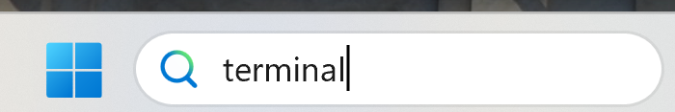
Run Terminal

Slide 6
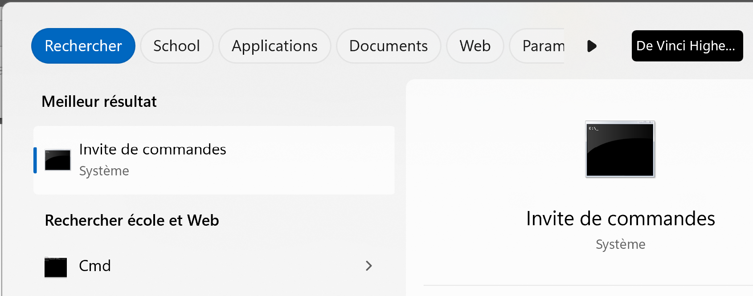
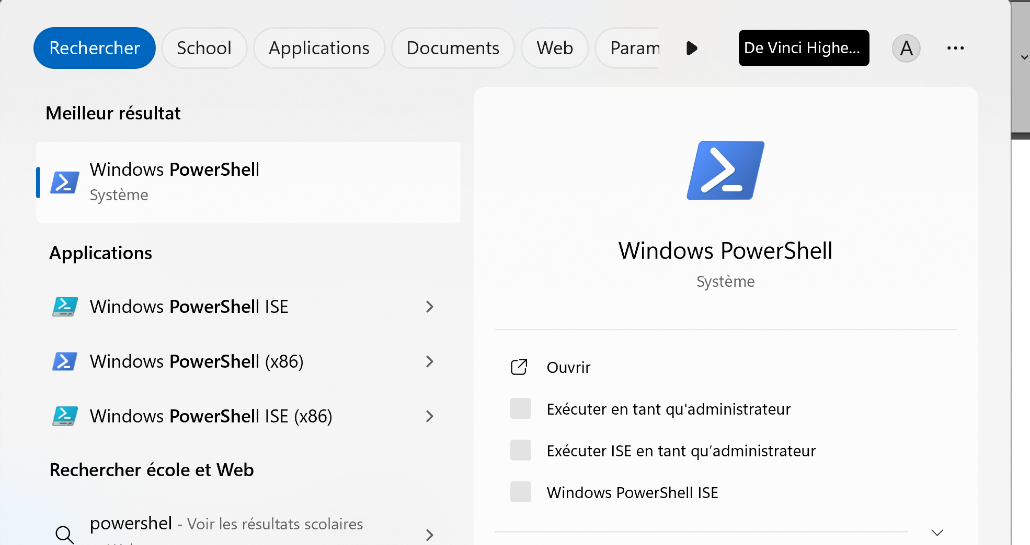
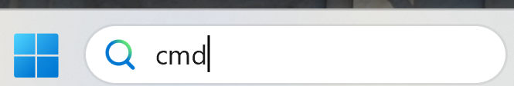
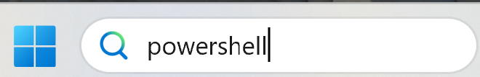
Terminal != Cmd Prompt (Invite de Command), != Power Shell

Slide 7
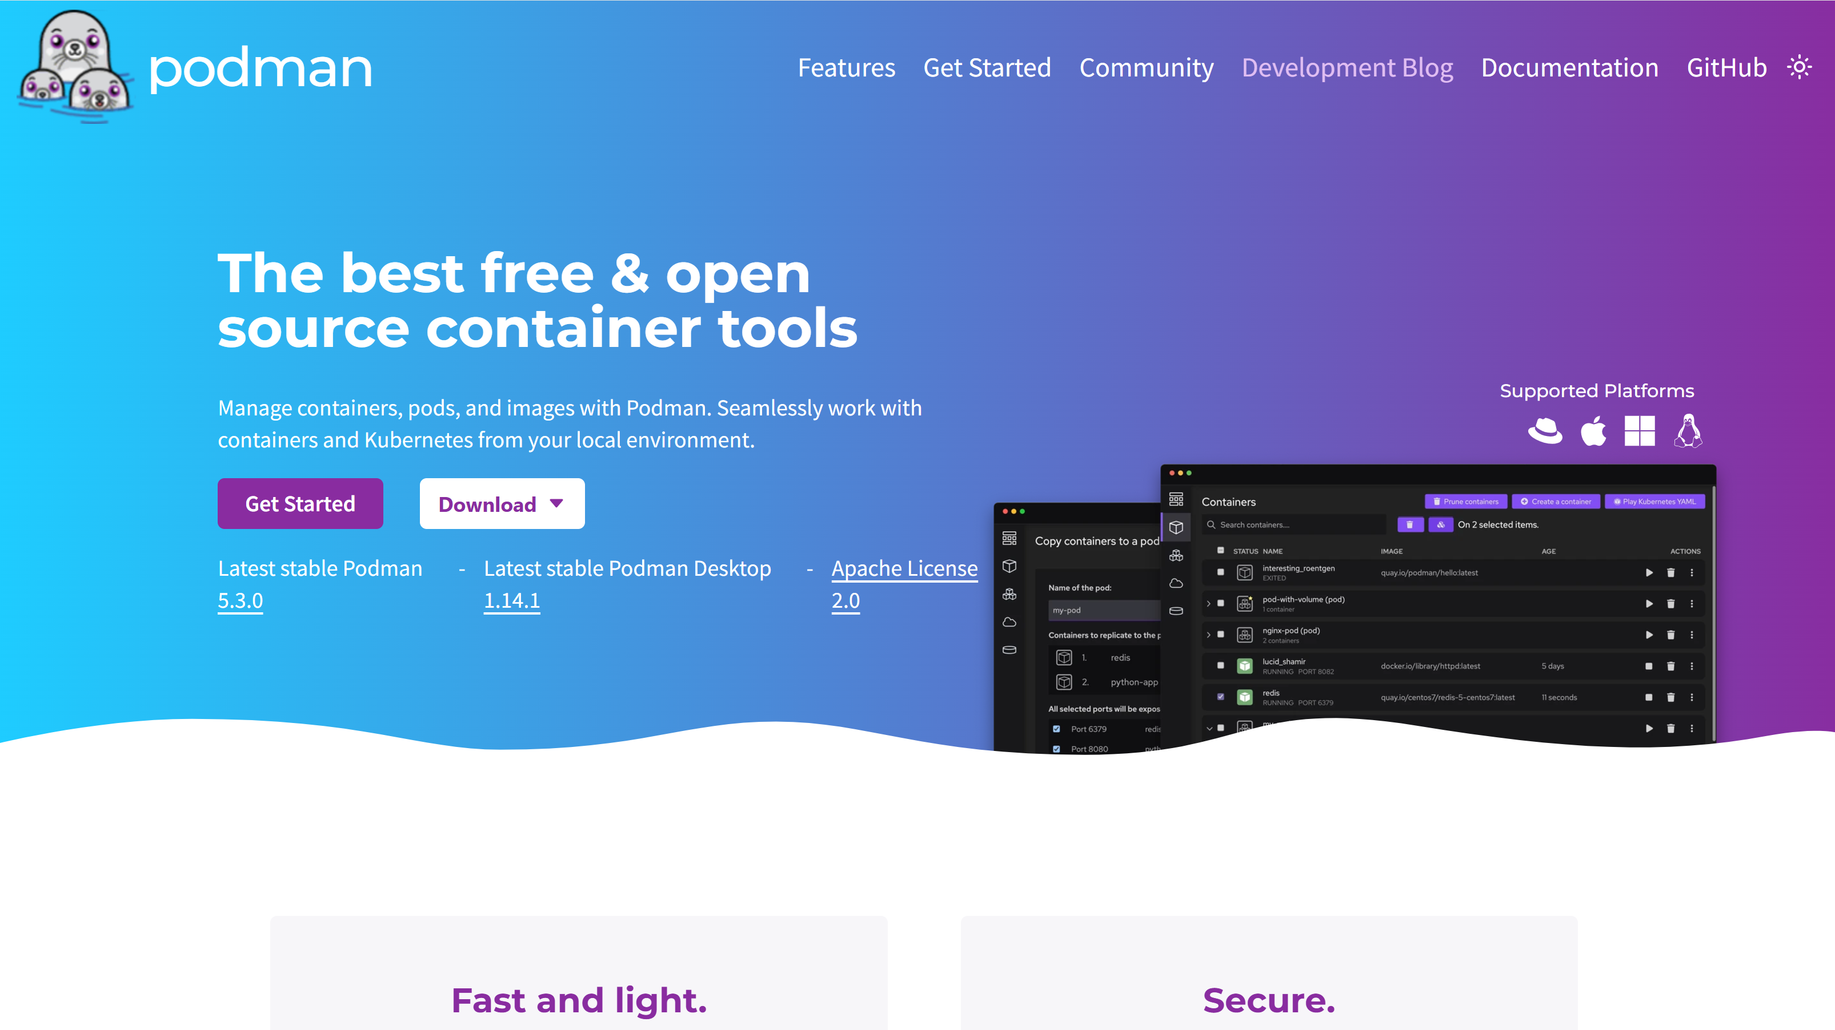
https://podman.io/
Podman is a replacement for "Docker" runtime, for Linux/Windows/Mac/, without root access
Podman also supports tools for easy Kubernetes interaction (minikube / kind / ..)

Slide 8
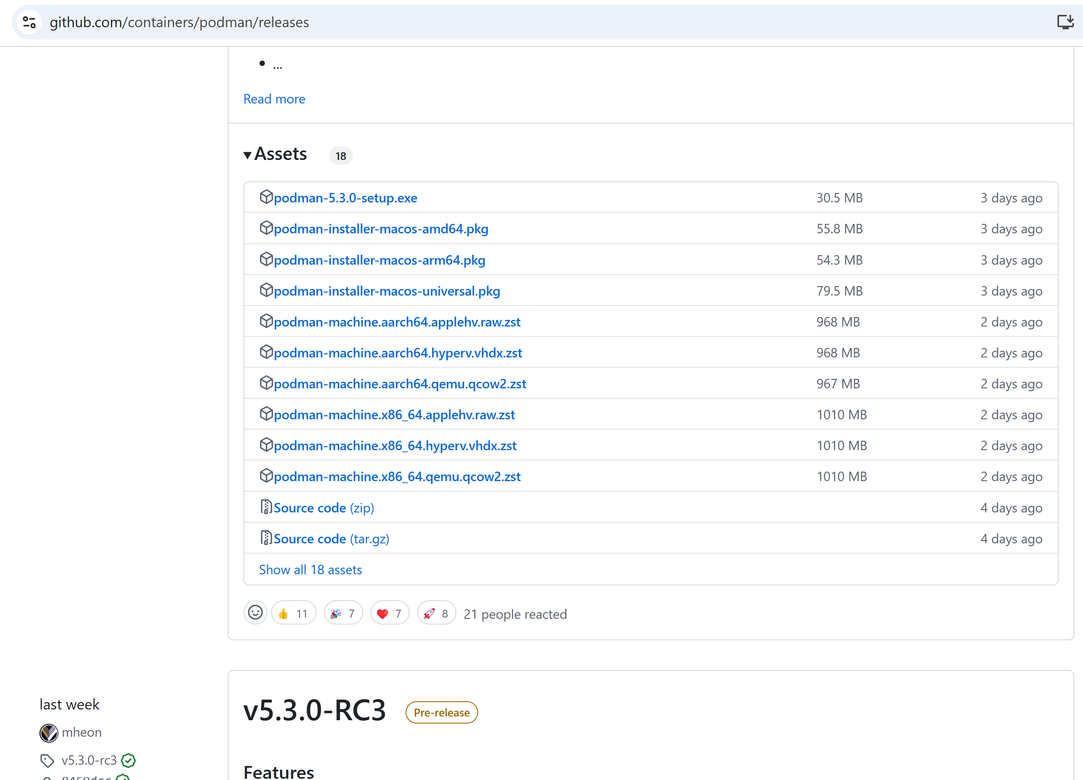
Download + exec "podman-{version} .setup.exe"
https://github.com/containers/podman/releases

Slide 9
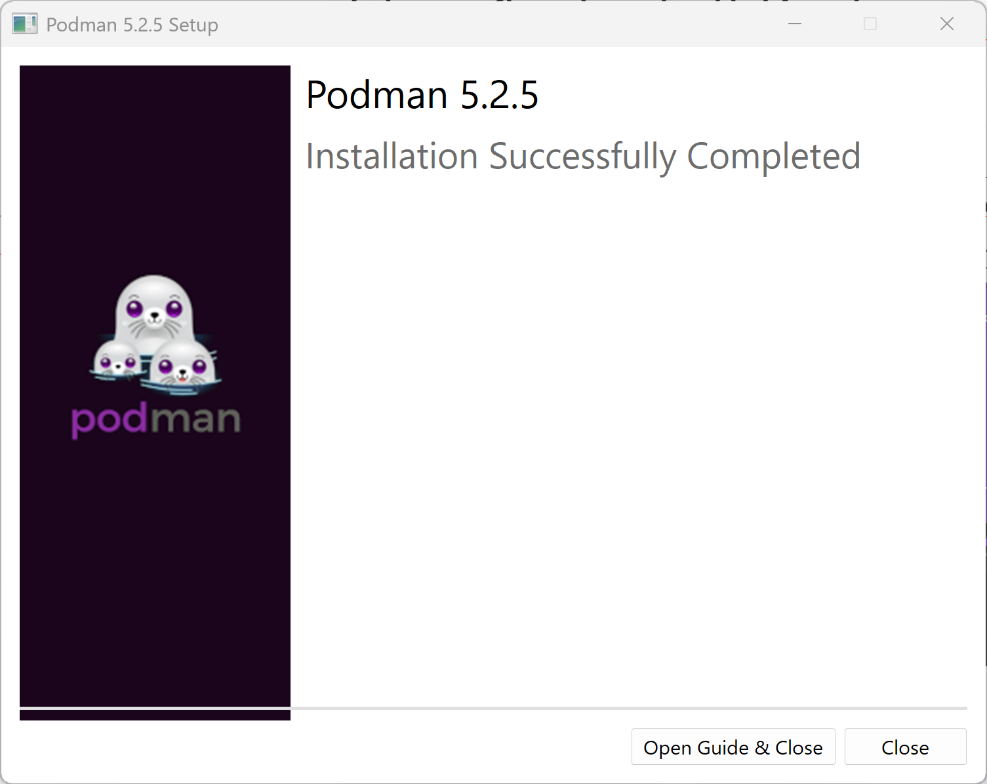
Podman Installed

Slide 10
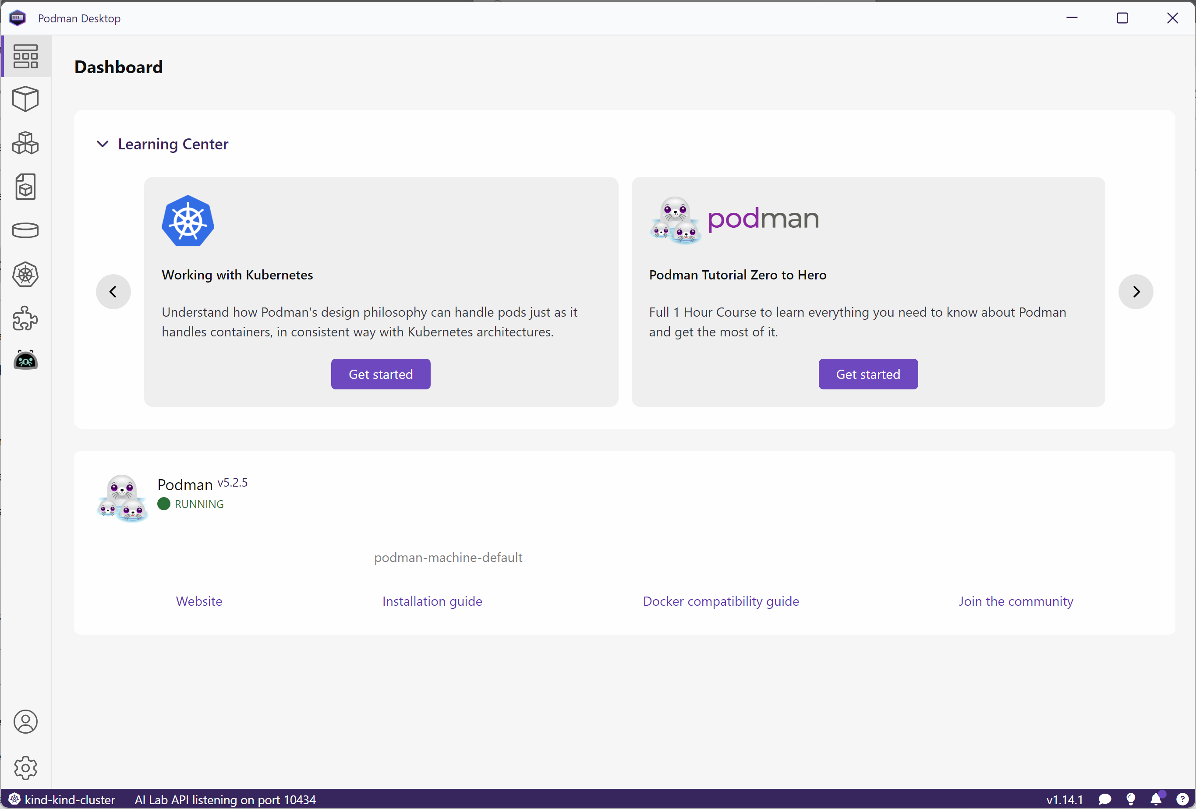
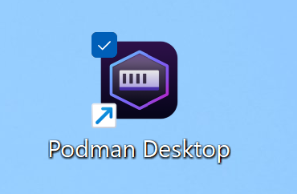
Launch & Explore interface

Slide 11
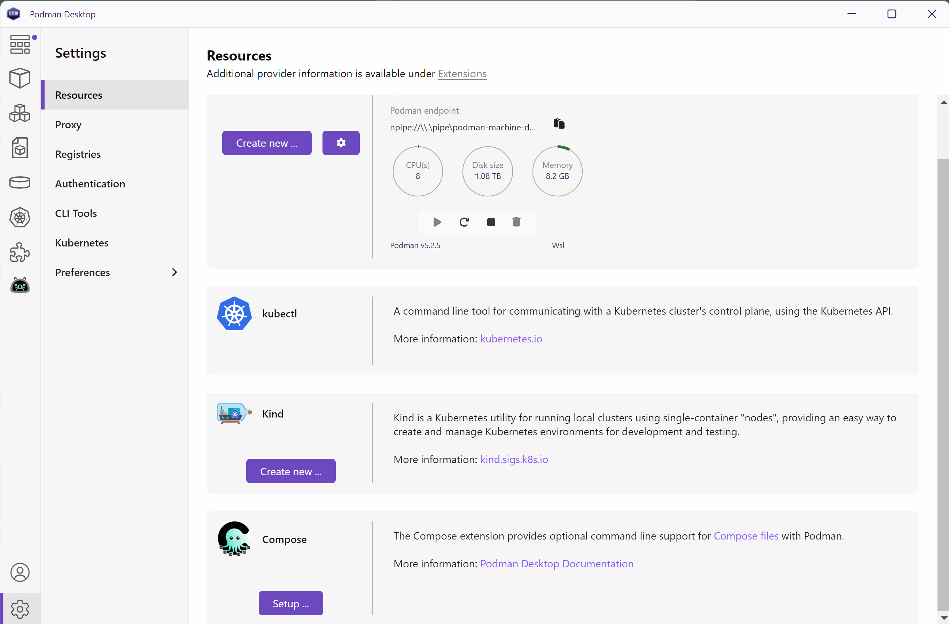
Create a k8s cluster: "Kind" (kind = "K"ubernetes "in" "D"ocker )

Slide 12
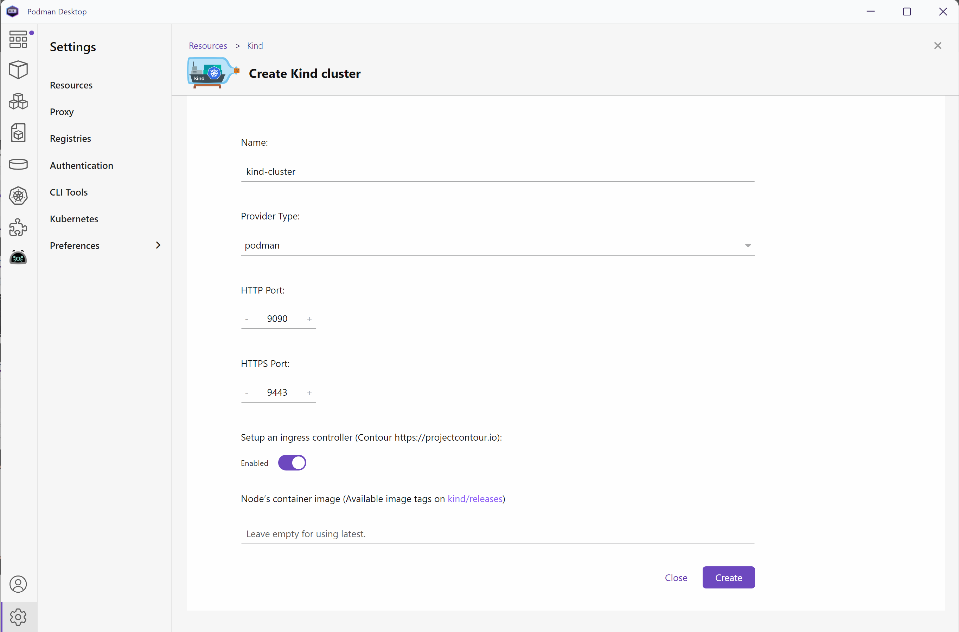
Create Kind

Slide 13
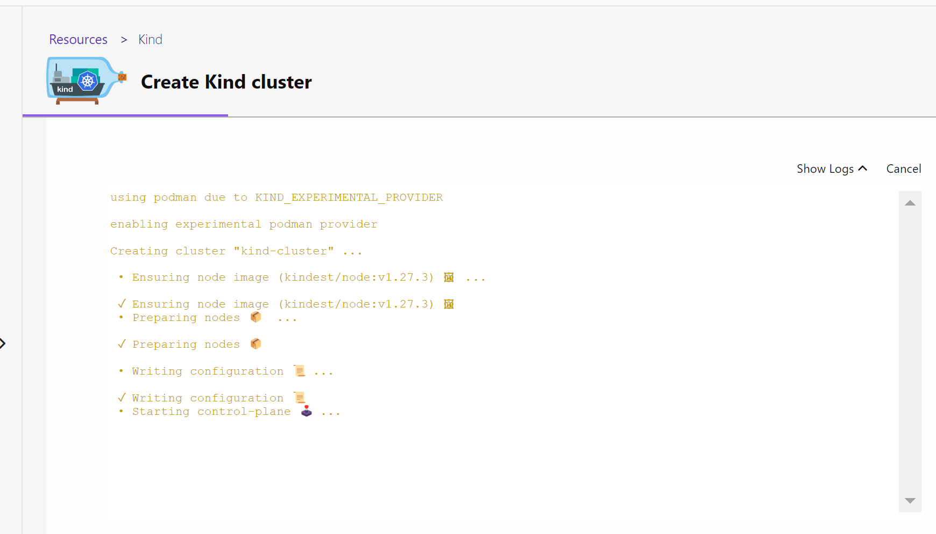
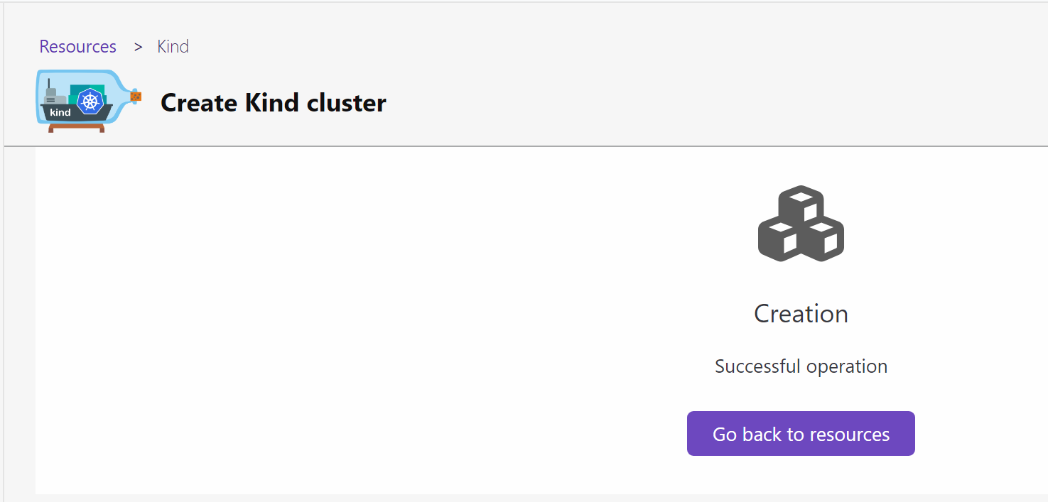
Wait ...

Slide 14
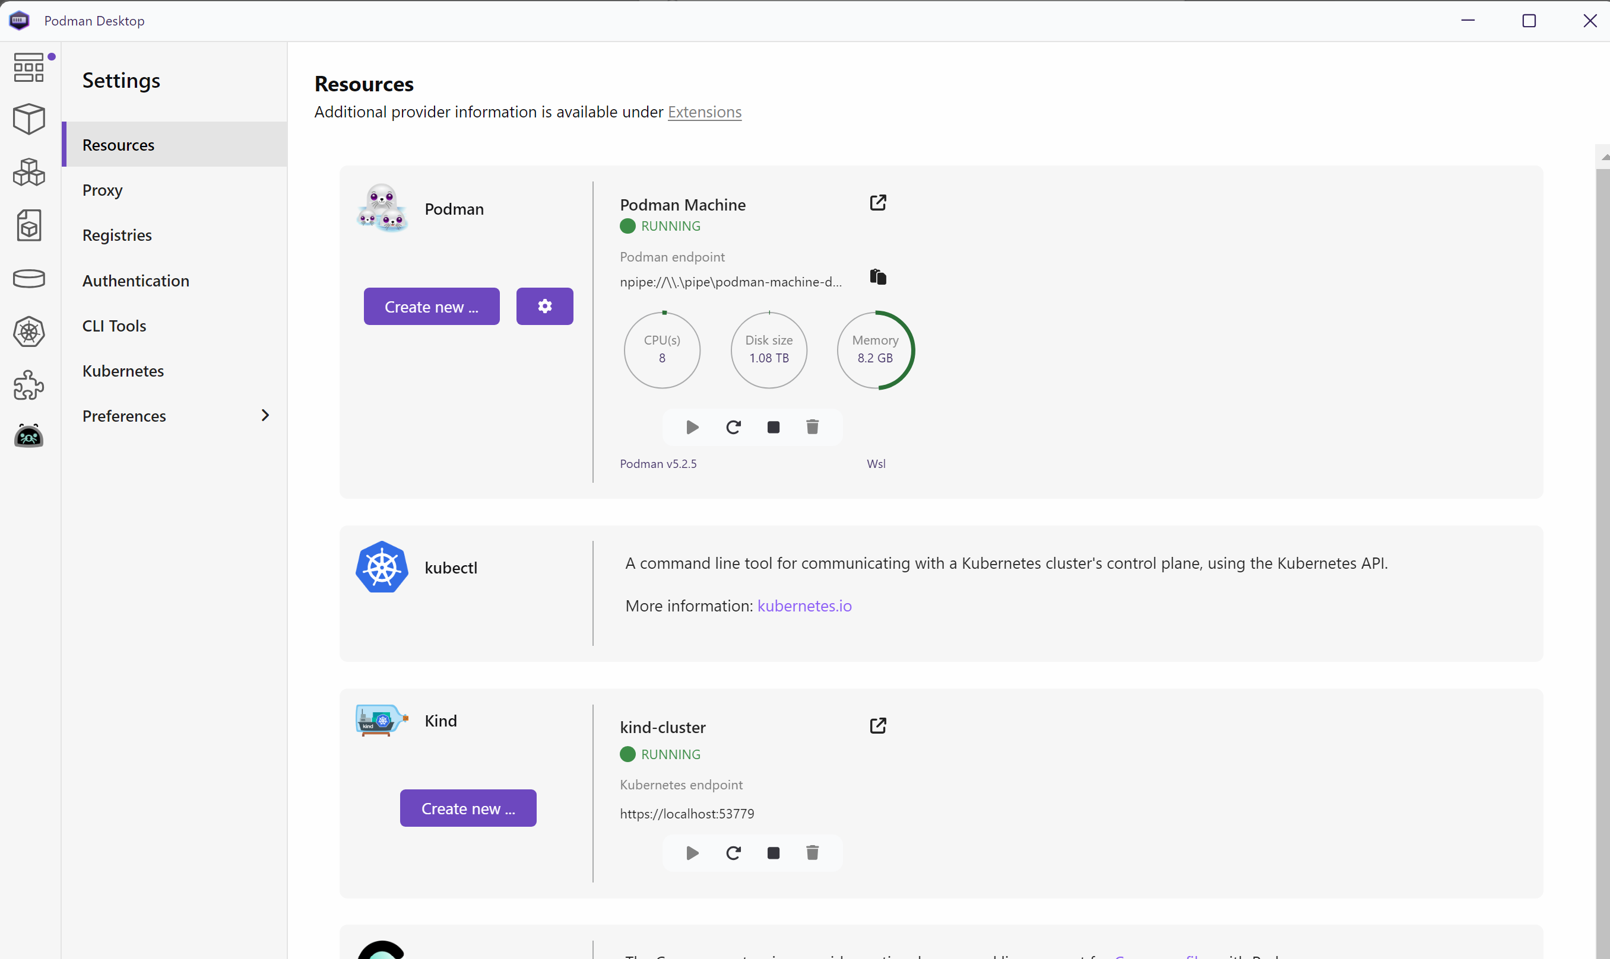
Kind is RUNNING

Slide 15
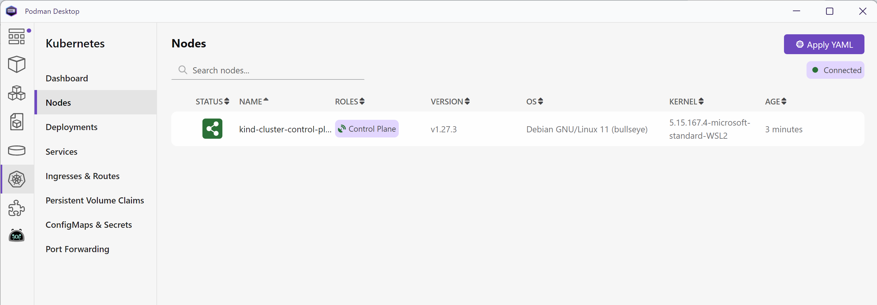
Kind - Nodes (only 1 : ControlPlane)

Slide 16
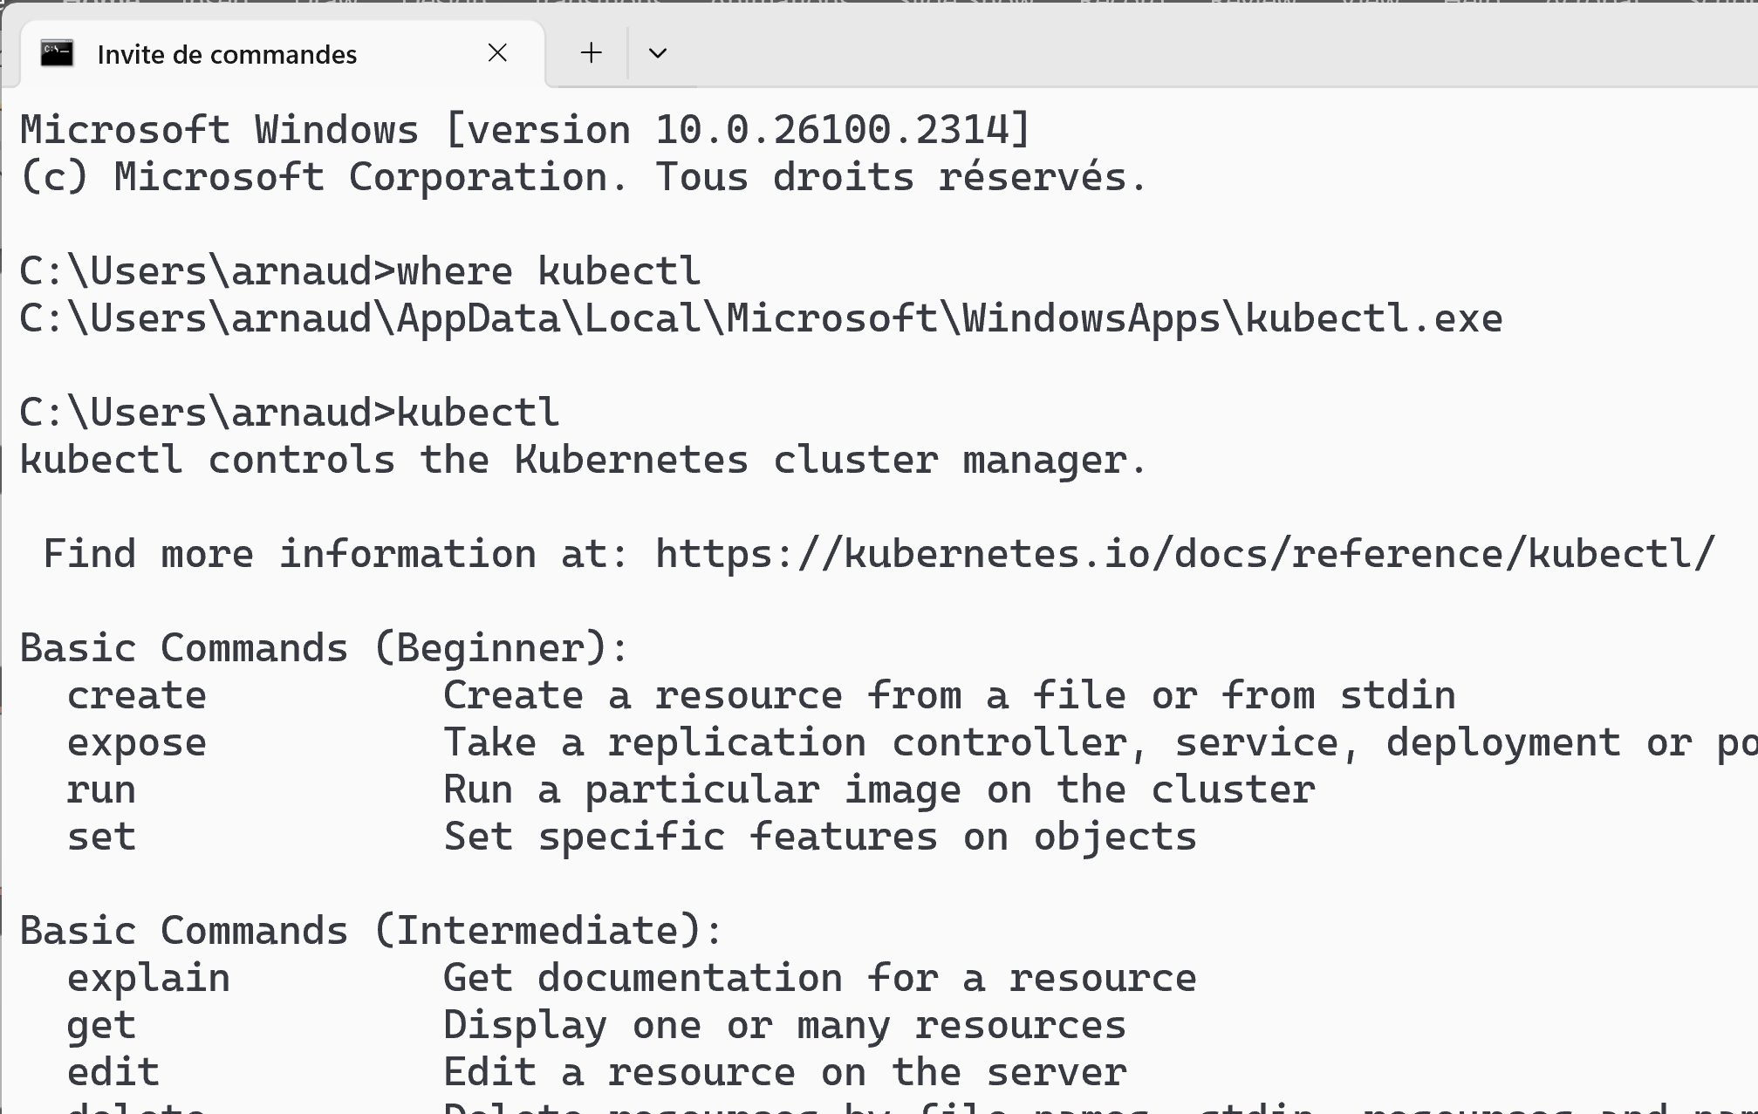
Open Terminal, check Kubectl

Slide 17
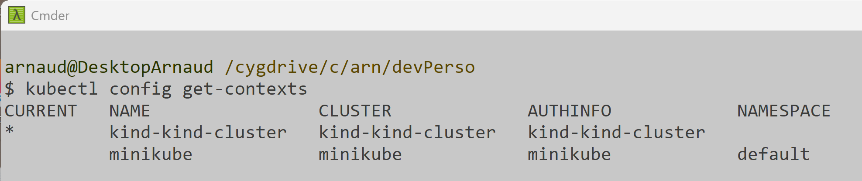
kubectl config get-contexts (cf standard aliases next: "kcgc")

Slide 18
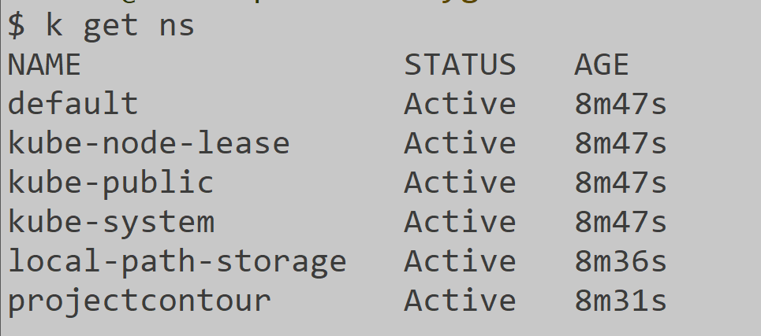
kubectl get ns (or k get ns ... see next for aliases)

Slide 19
Optional: install K8s helper tools

Slide 20
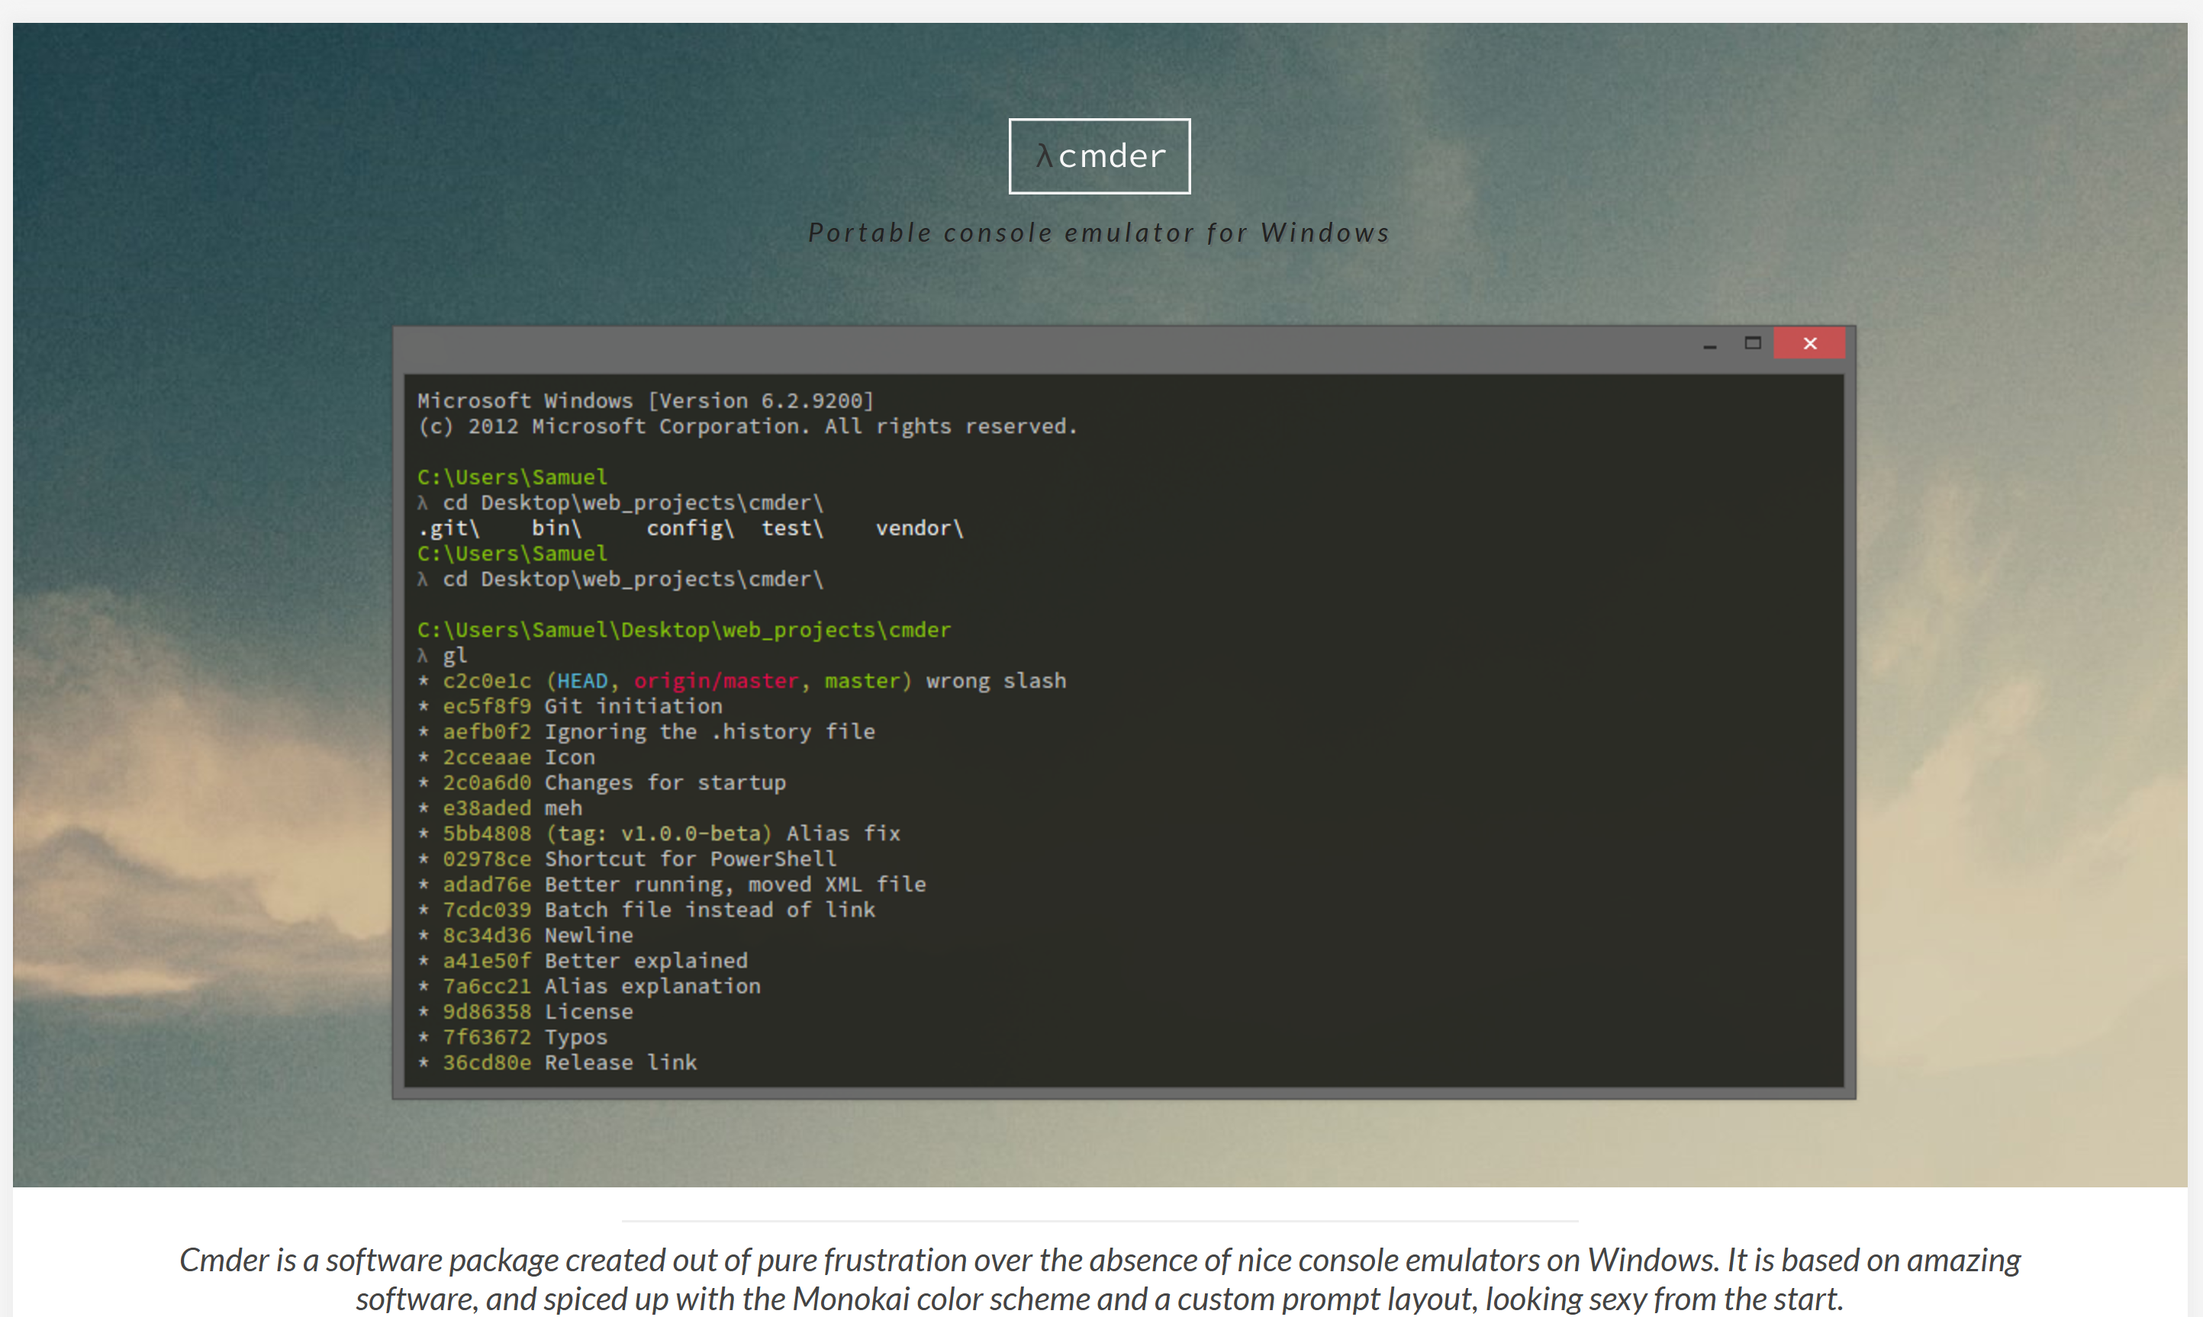
(Optional) Install Cmder https://cmder.app/ for "Bash" (without cygwin) and do not use "cmd DOS" nor "PowerShell" !!

Slide 21
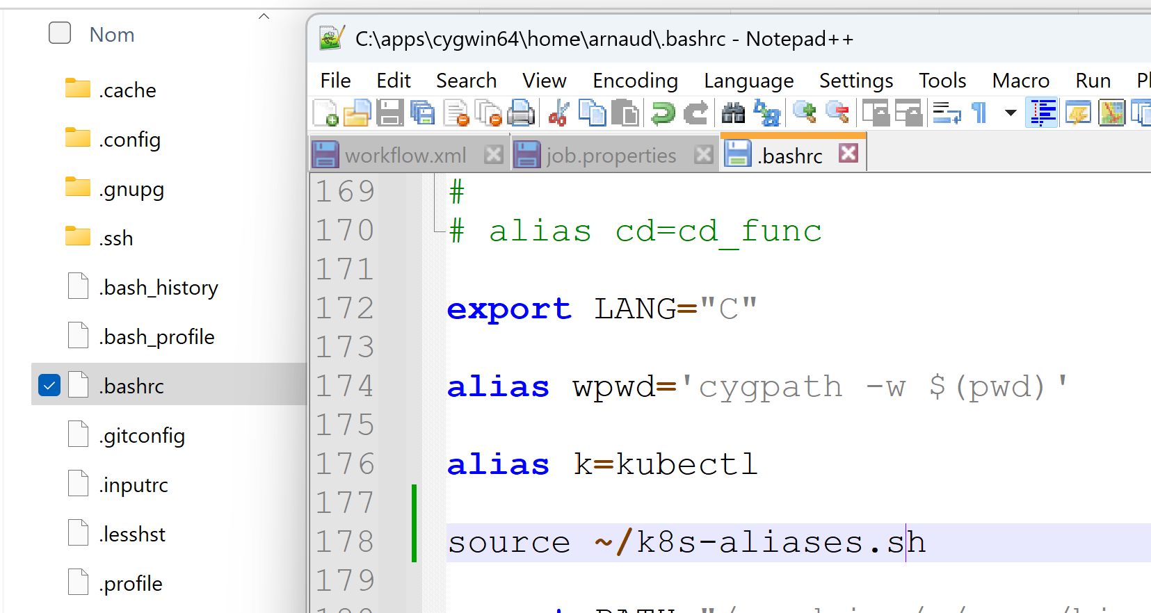
(Optional) usefull on Bash shell : aliases alias k=kubectl alias kg=kubectl get; alias kgp=kubectl get pod; ....

Slide 22

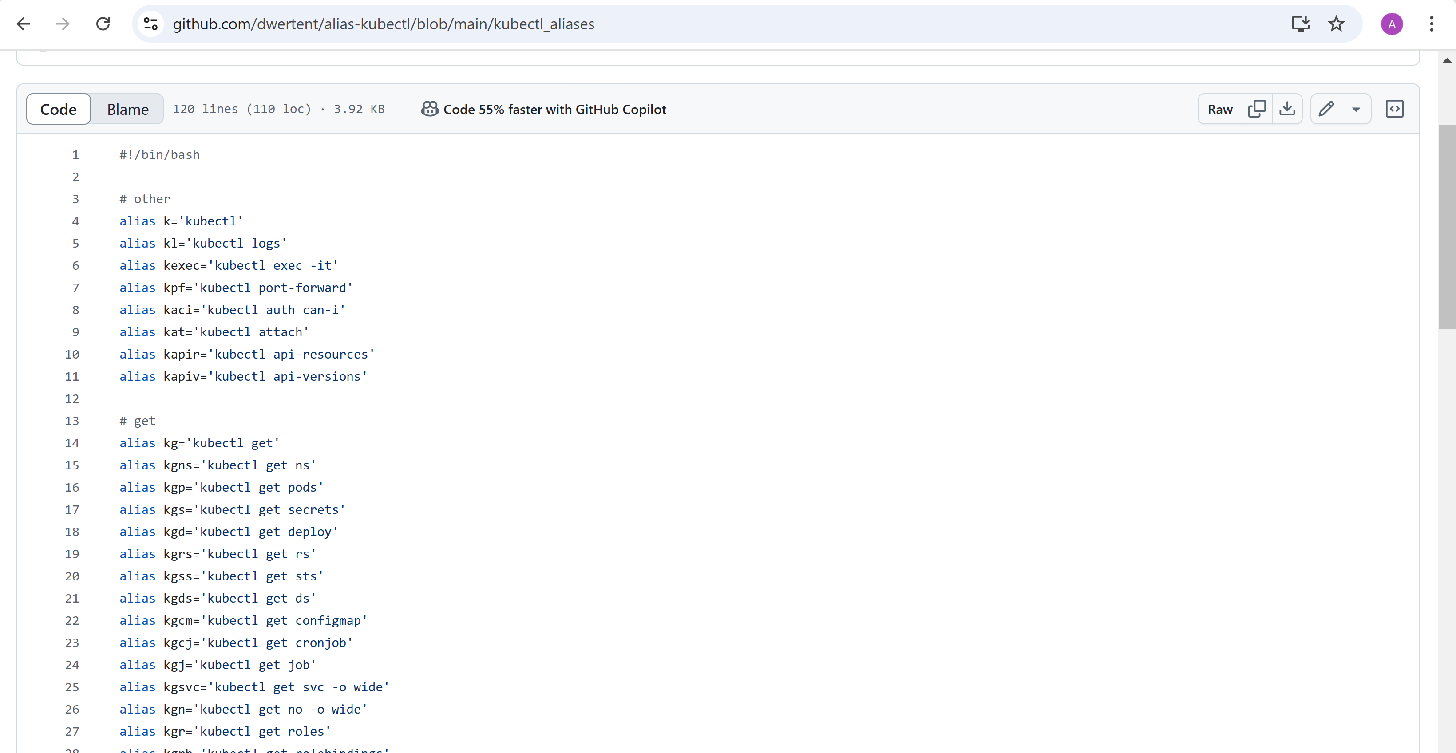
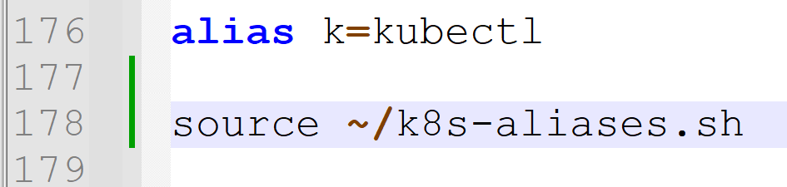
(Optional) usefull on Bash shell loading many aliases from "sourced" file

Slide 23
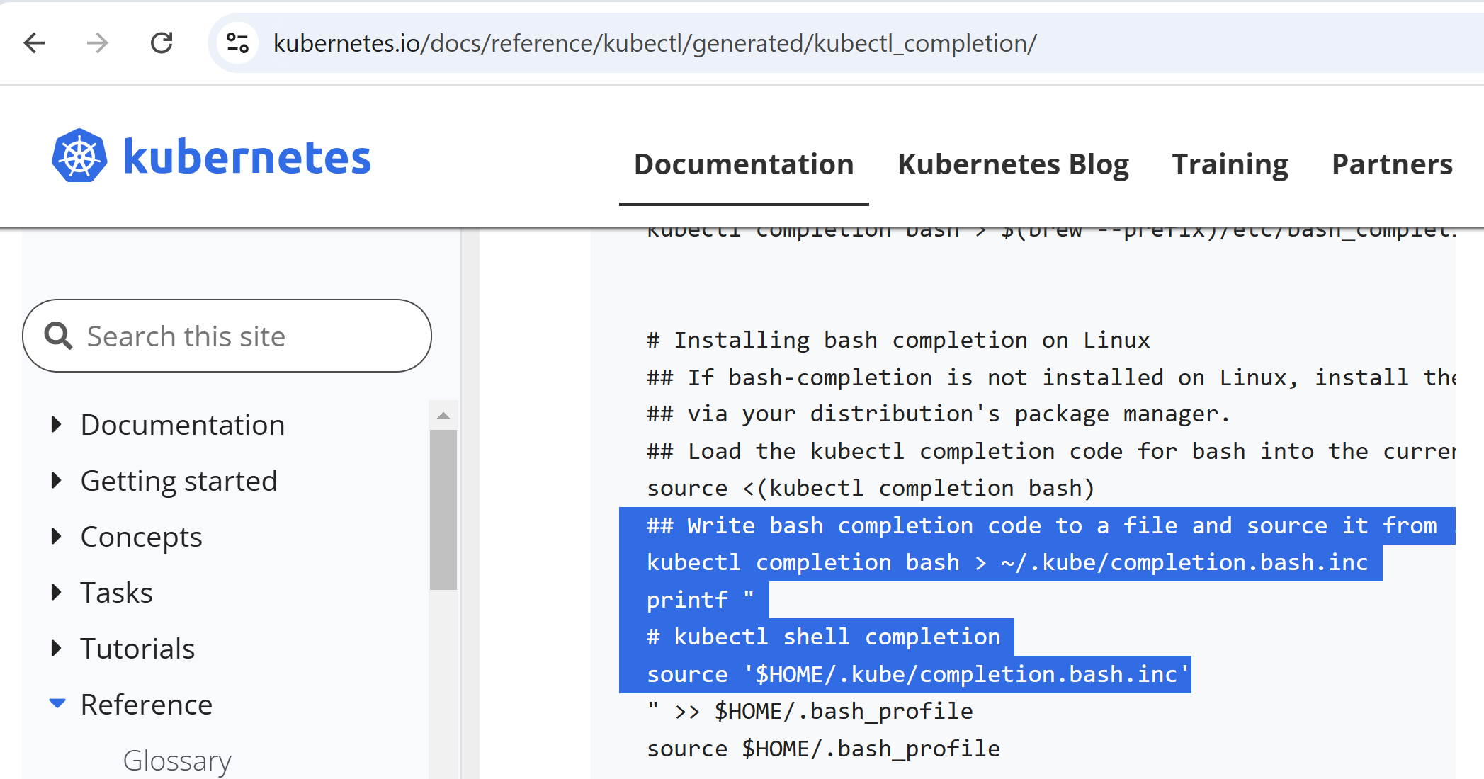
(Optional) Usefull Bash Completions

Slide 24
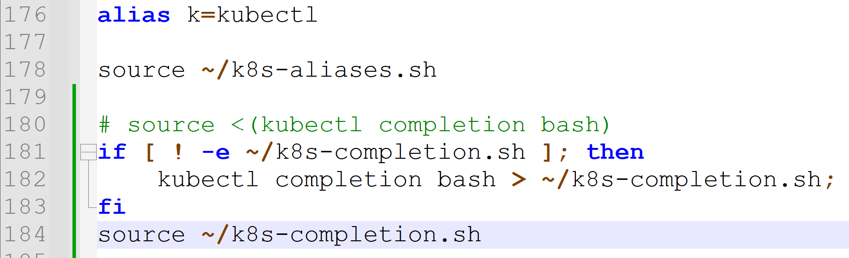
Kubectl Bash Completions
source <(kubectl completion bash)

Slide 25
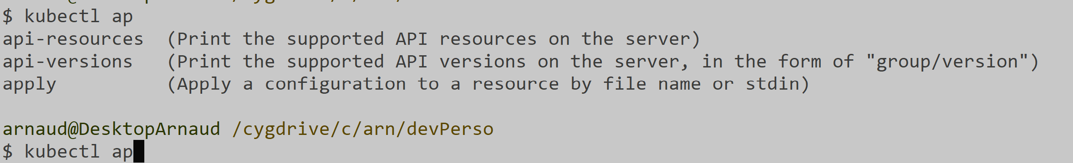


kubectl <cmd><tab> for autocompletion
start typing "ap" then <tab><tab> => propose several auto completions
start typing "app" then <tab> => resolved unique completion "apply"

Slide 26
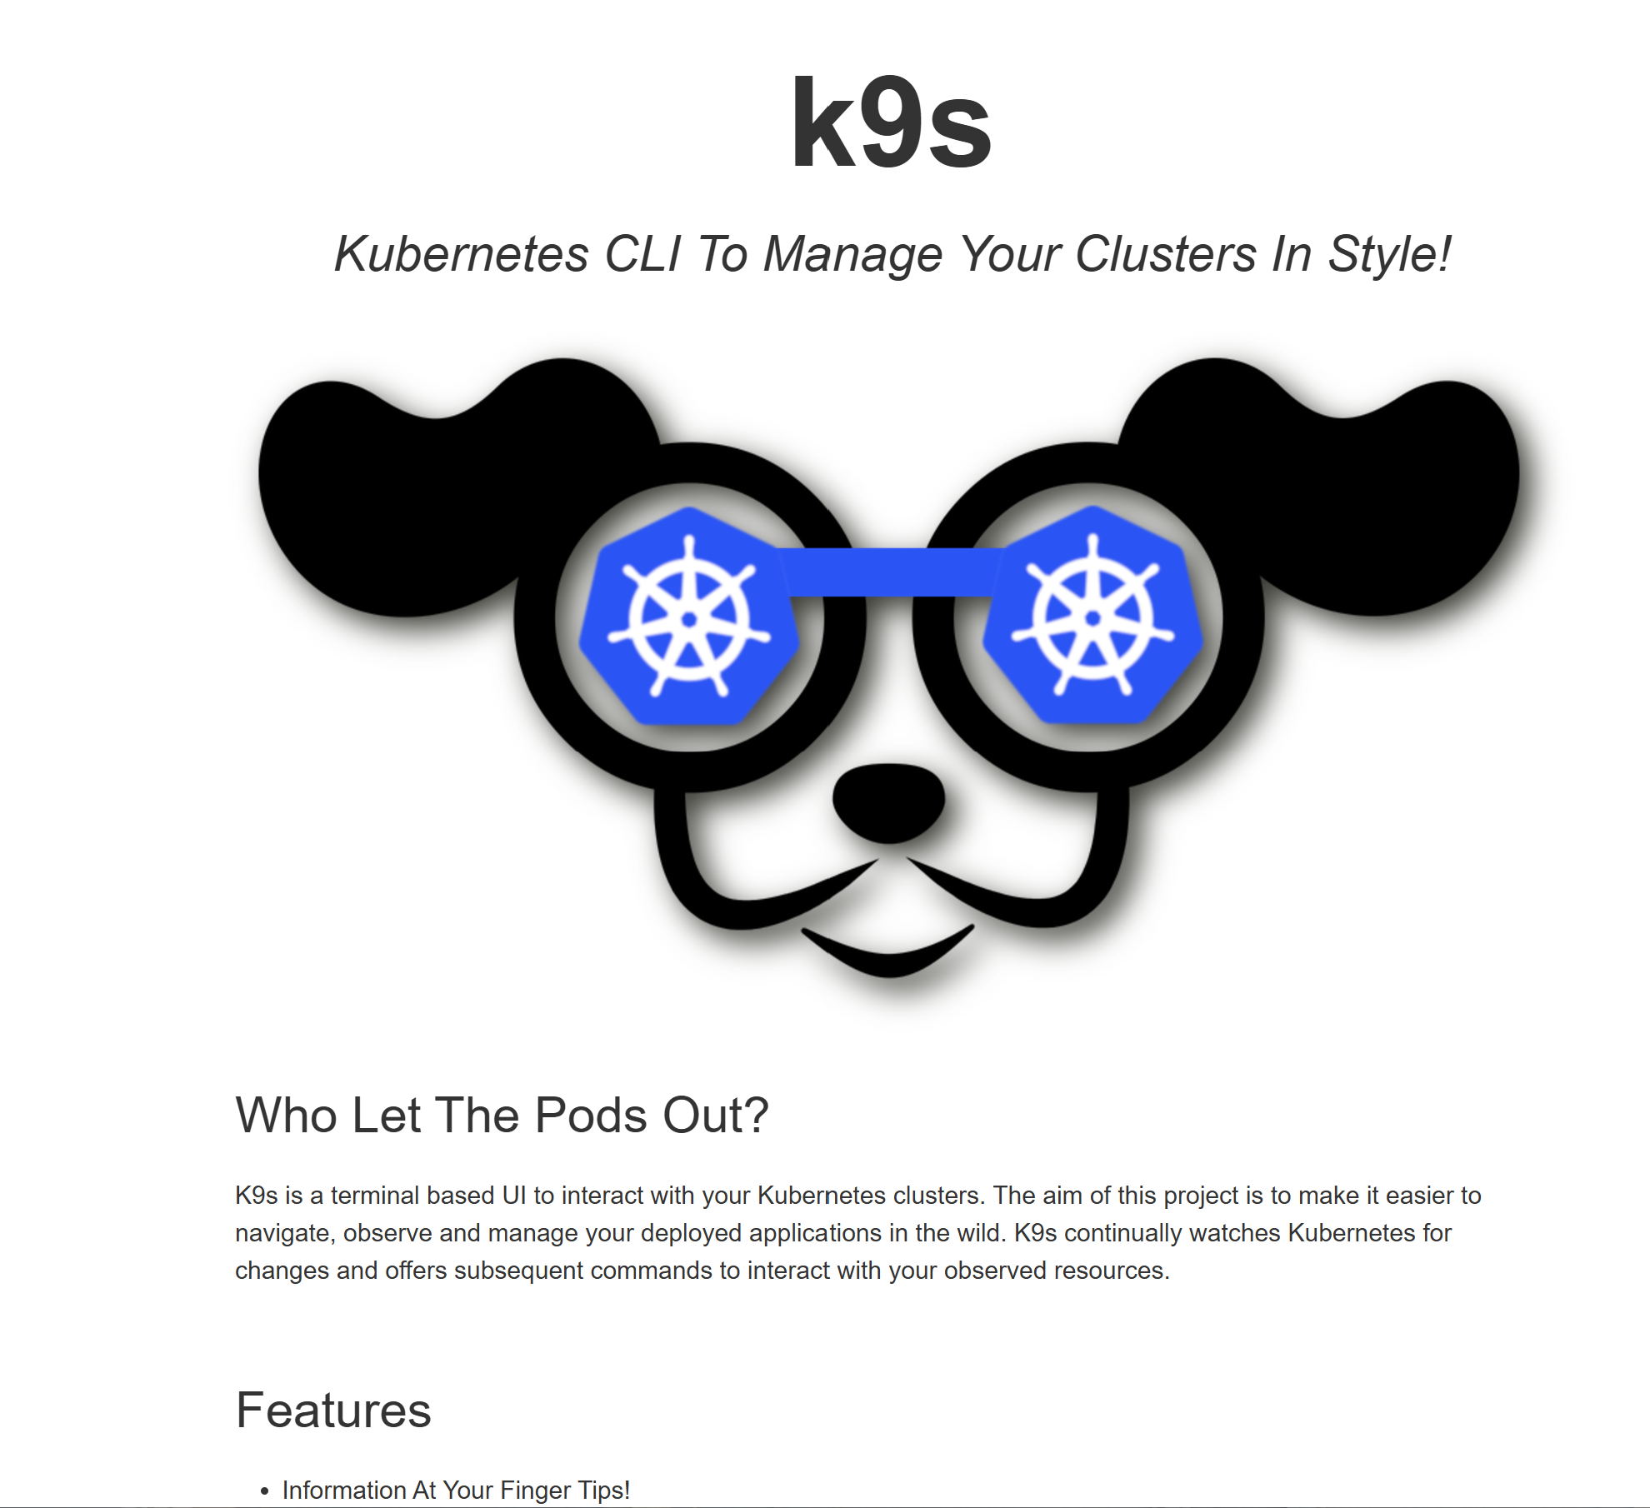
Install Utility CLI tool : "k9s"

Slide 27
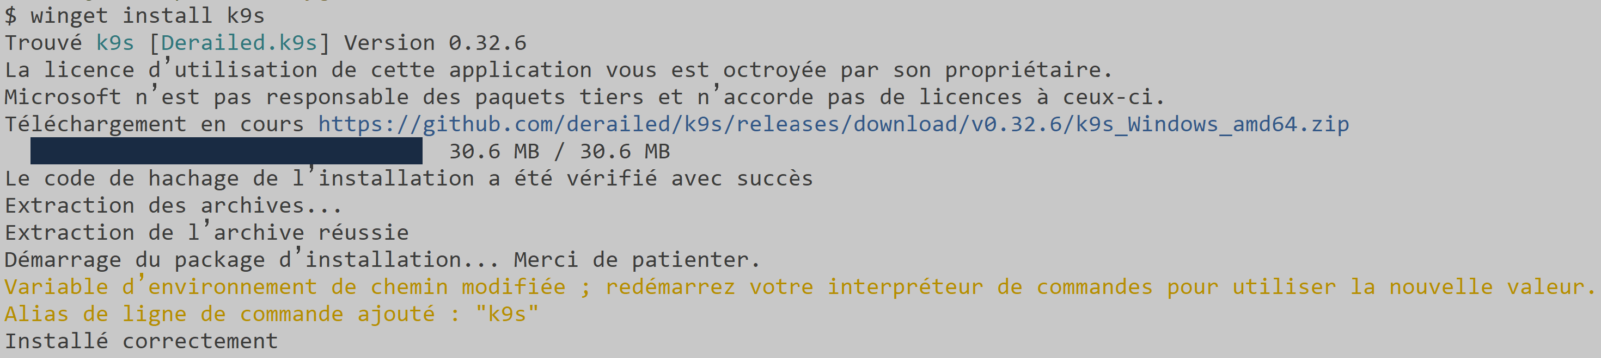
https://k9scli.io/topics/install/
winget install k9s

Slide 28
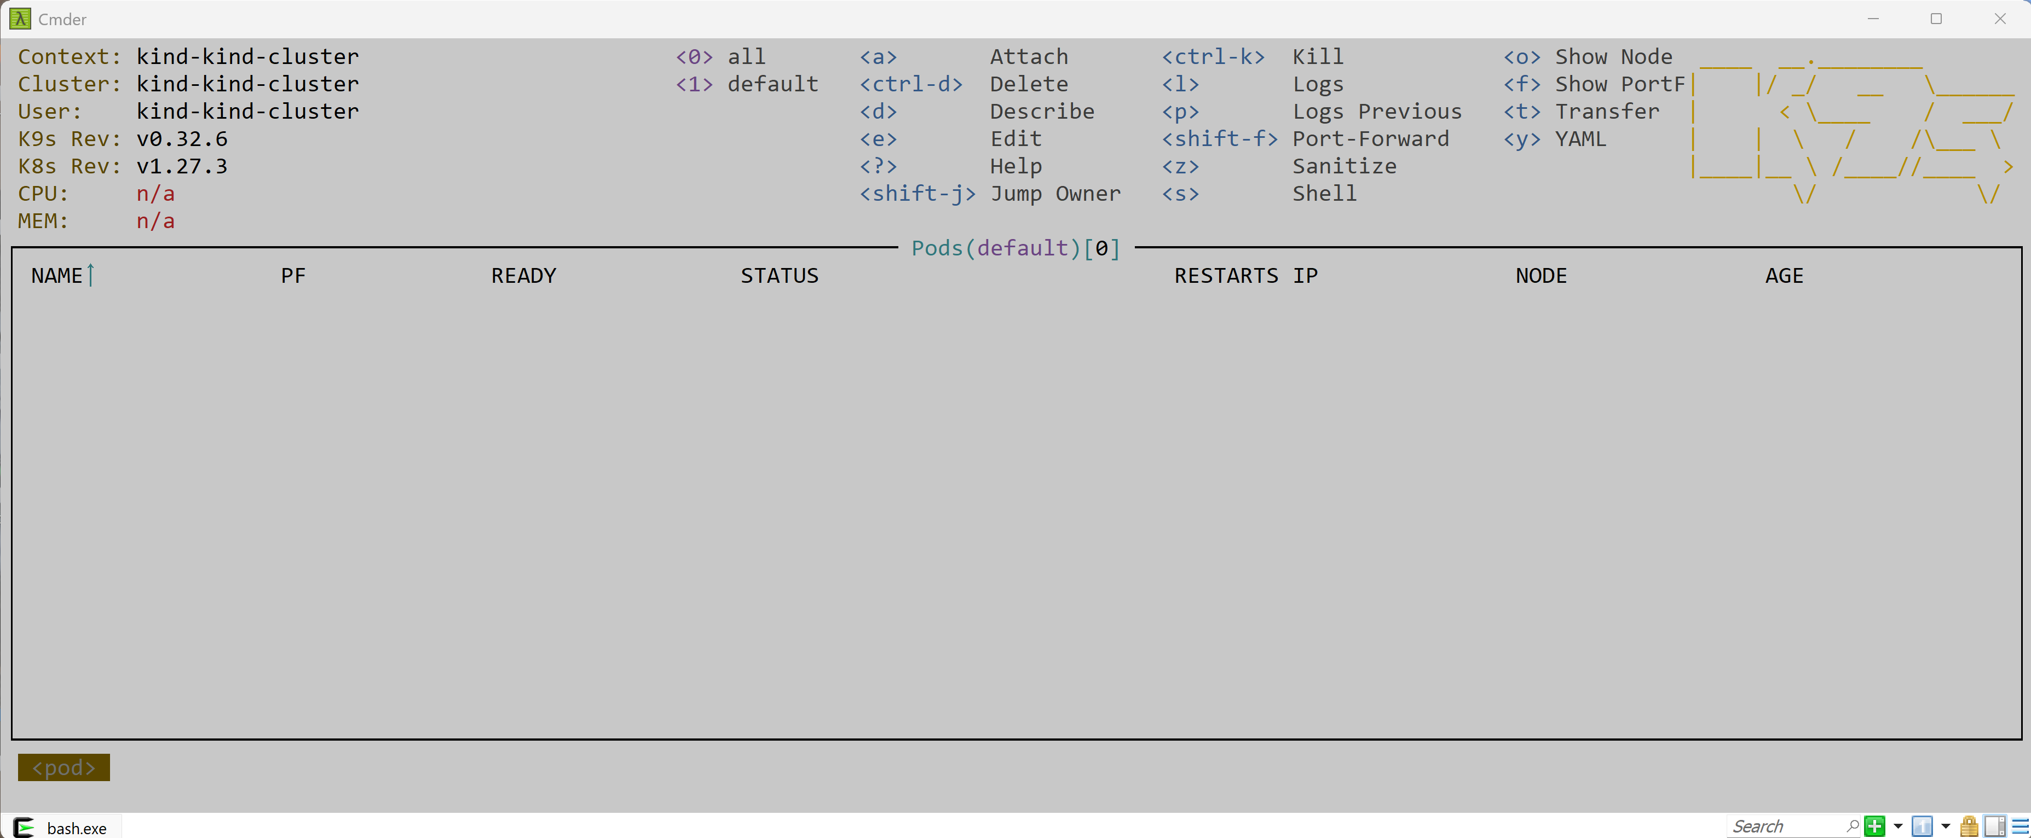
using k9s

Slide 29
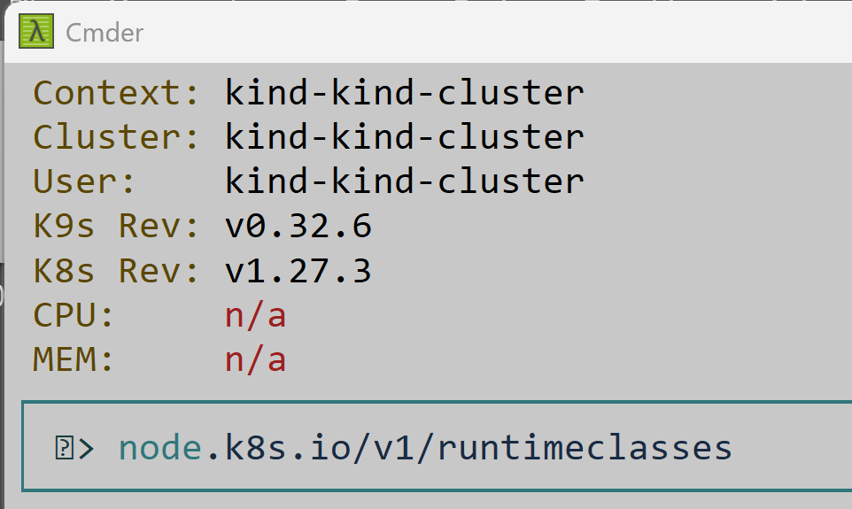
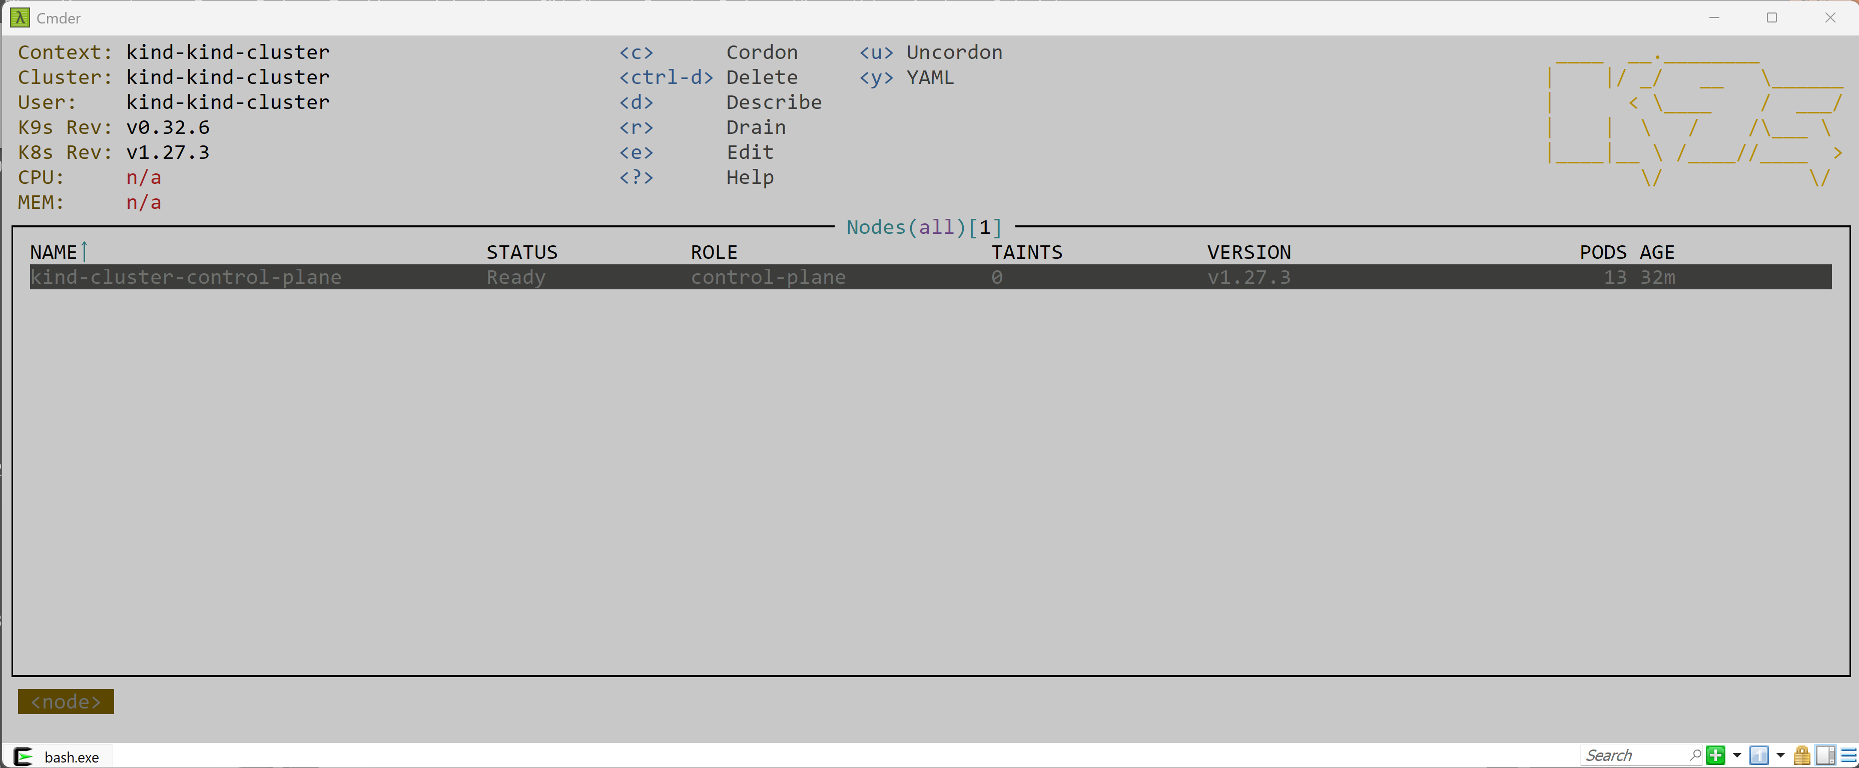
switch between pod, node, deployment: type "<ESCAPE> :node <ENTER>"

Slide 30
Helm

Slide 31
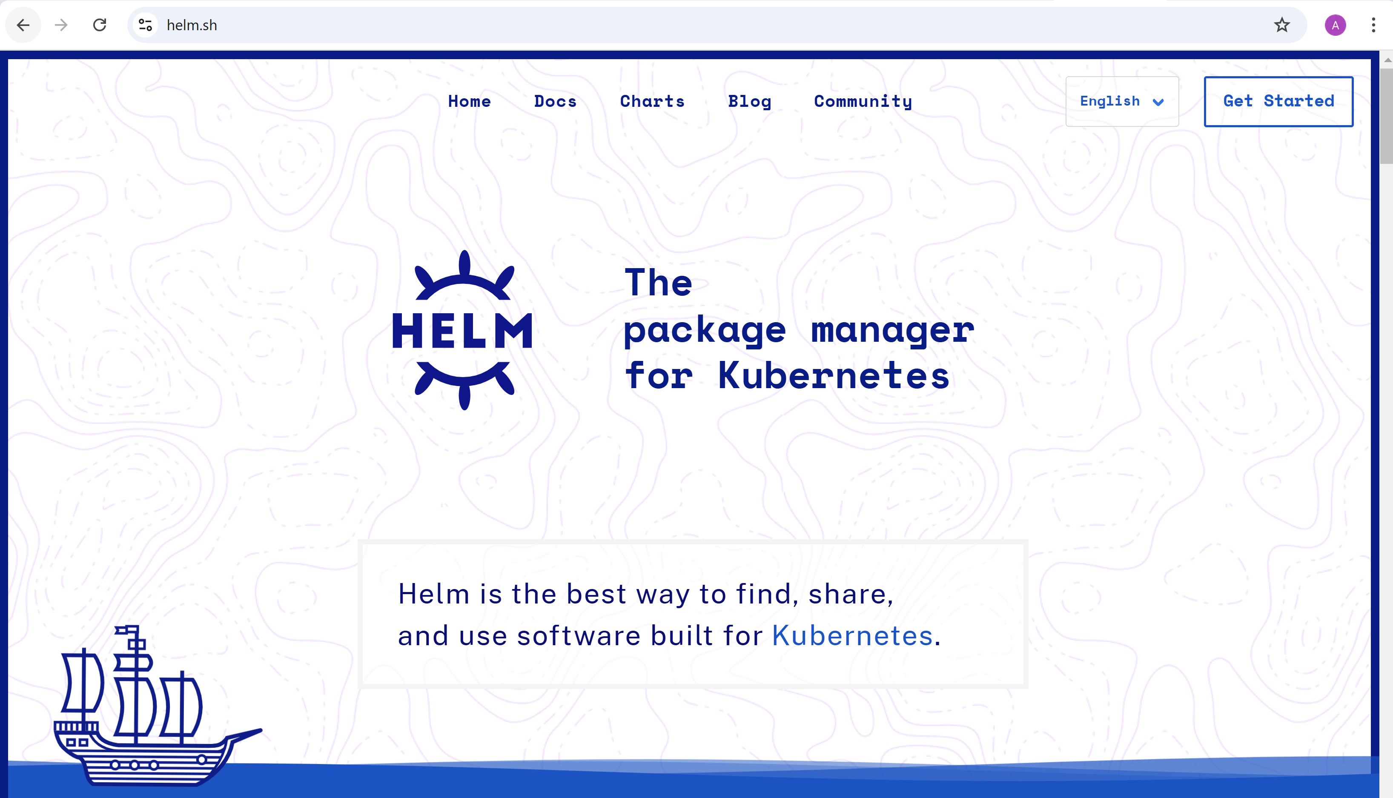
https://helm.sh

Slide 32
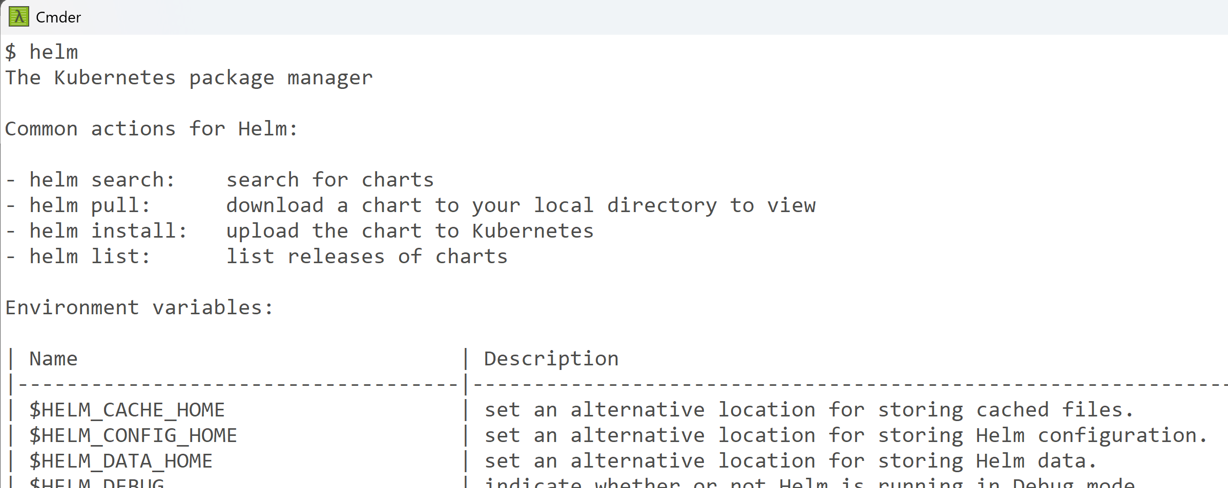
Check/Install "Helm" command line

Slide 33

helm list
Nothing installed yet ... We need "spark operator for k8s"

Slide 34
Helm Install Spark Operator for K8s

Slide 35
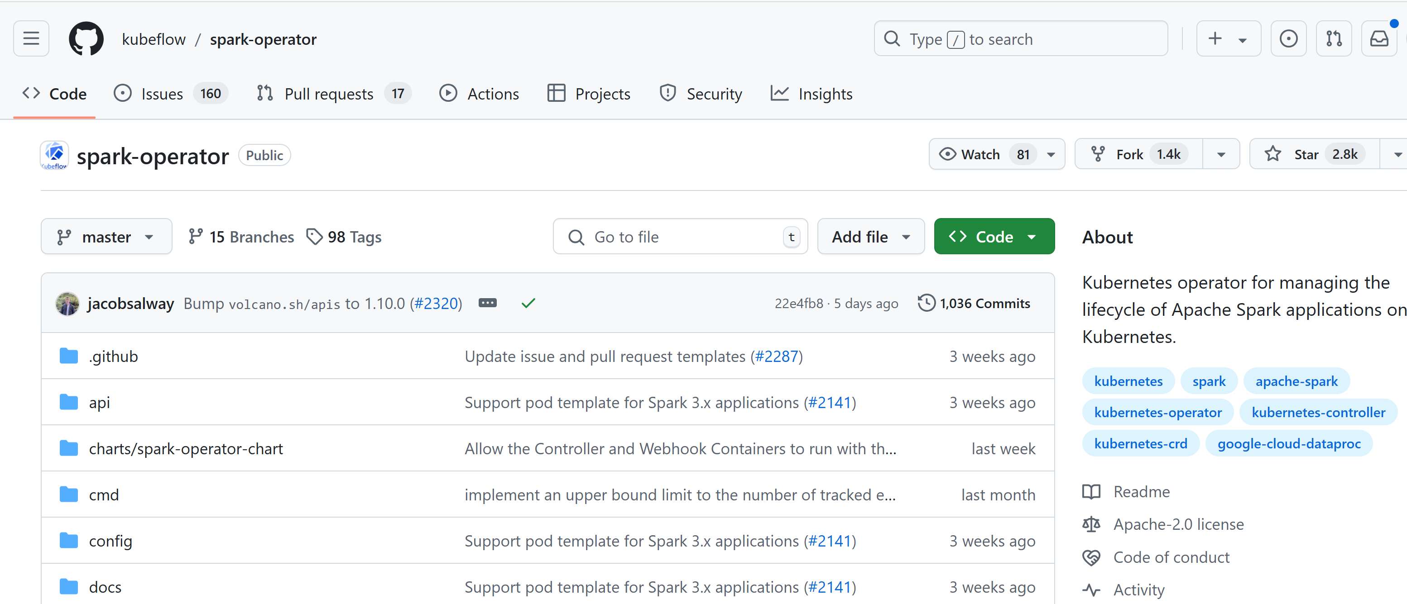
https://github.com/kubeflow/spark-operator

Slide 36
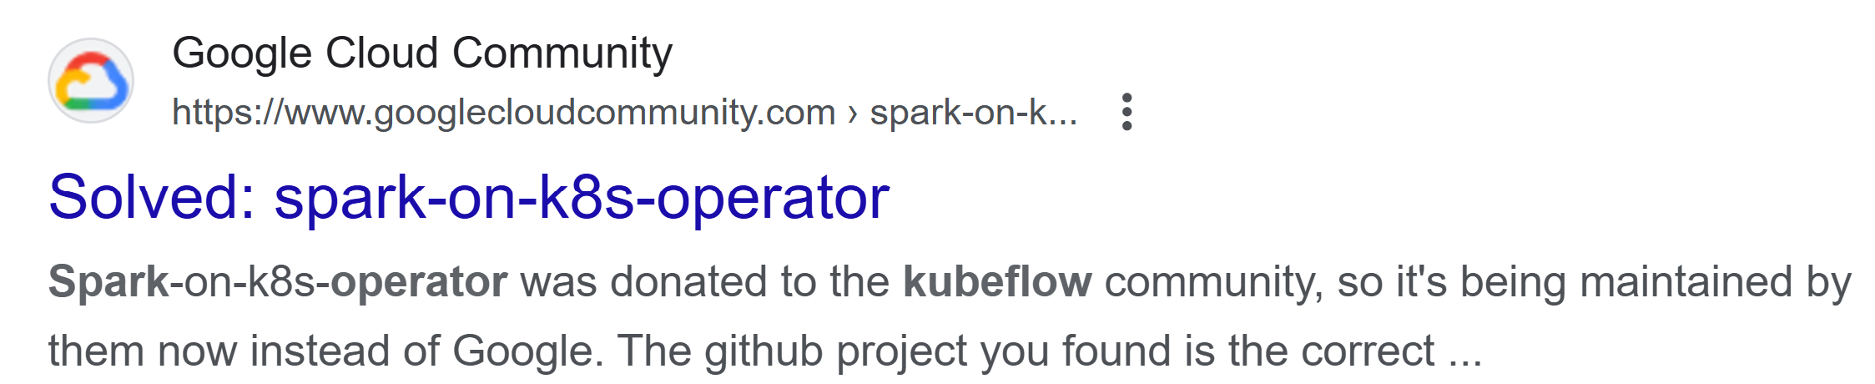
Notice... https://github.com/GoogleCloudPlatform/ spark-on-k8s-operator ( origin, now automatically redirected to kubeflow)

Slide 37
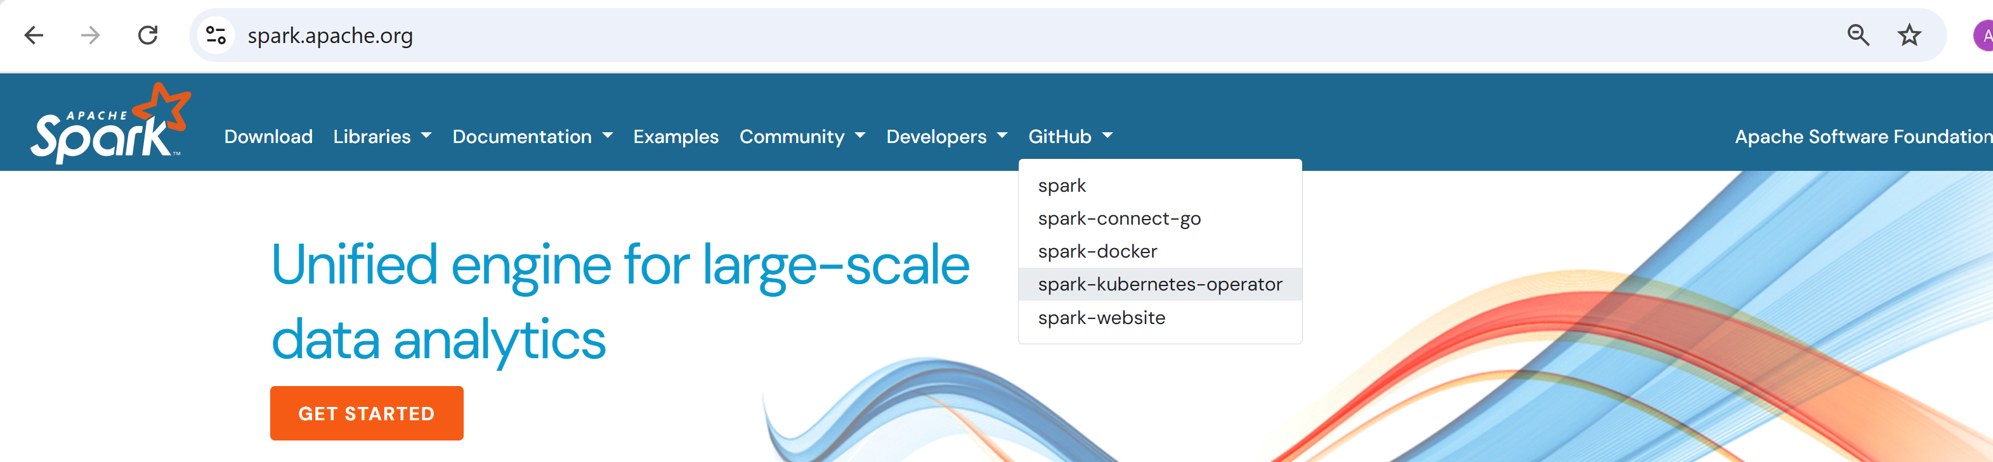
Notice: another operator... in apache spark official doc

Slide 38
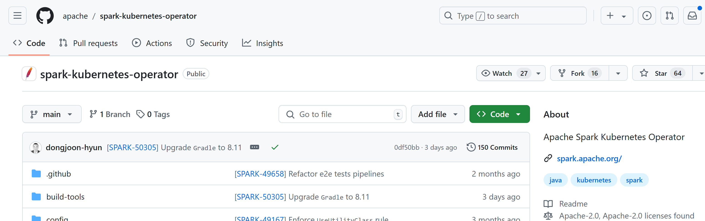
https://github.com/apache/ spark-kubernetes-operator
confusing ...

Slide 39
WARN ...
This TD is using the "kubeflow" operator
the kubeflow operator manage these types:
apiVersion: sparkoperator.k8s.io/v1beta2
kind: SparkApplication
kind: ScheduledSparkApplication
!= the "apache" one,
the apache operator manages theses types: apiVersion: spark.apache.org/v1alpha1
kind: SparkCluster
kind: SparkApplication

Slide 40
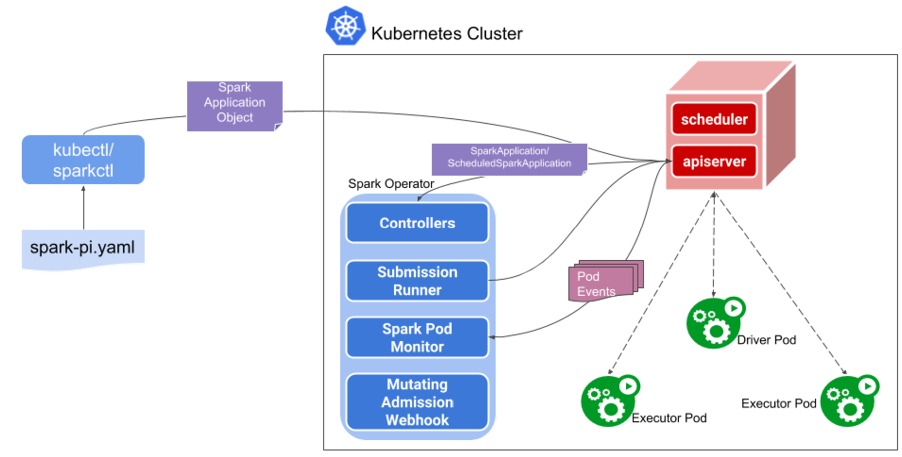
doc https://www.kubeflow.org/docs/components/spark-operator

Slide 41
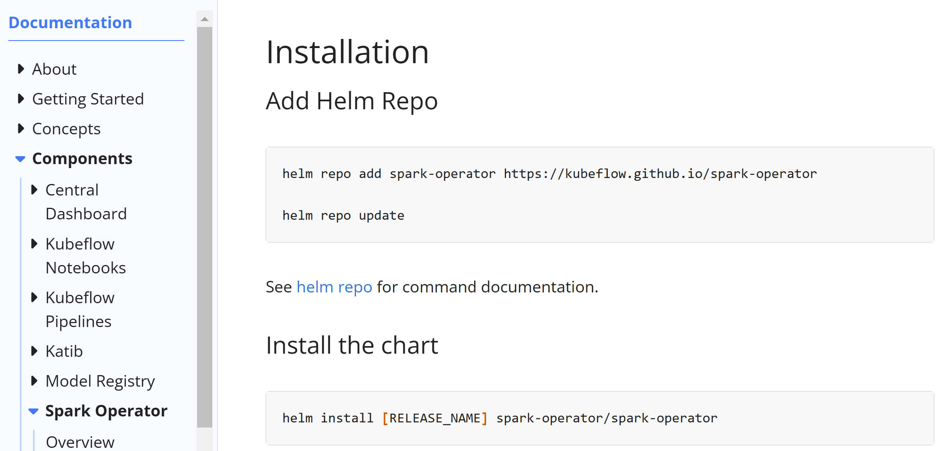
https://www.kubeflow.org/docs/components/spark-operator/getting-started/

Slide 42
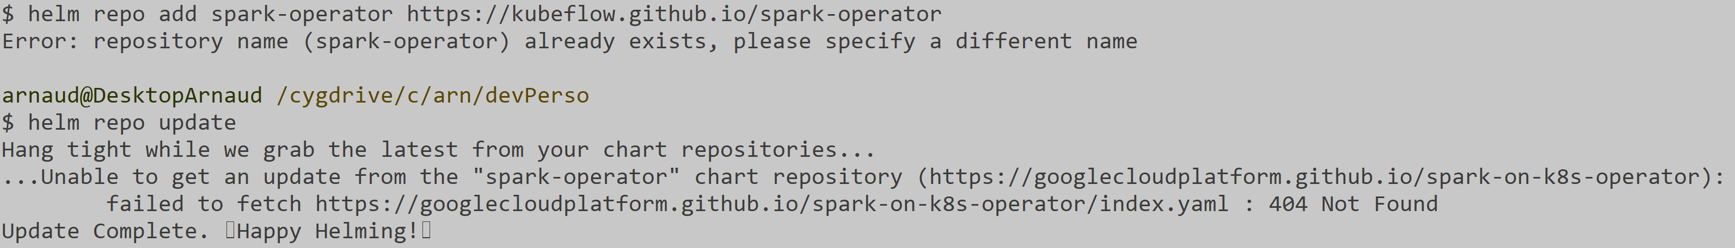
OLD repo already exist (but invalid) ... Failed to update

Slide 43
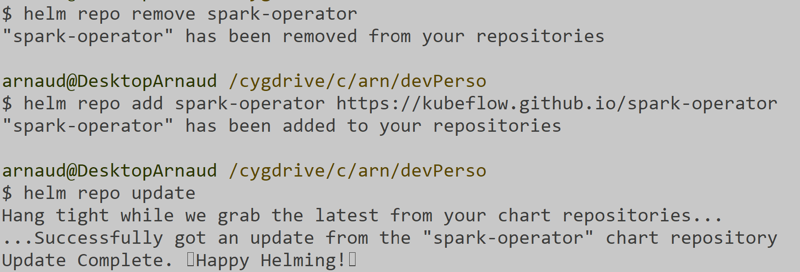
remove + re-add
helm repo remove spark-operator
helm repo add spark-operator https://kubeflow.github.io/spark-operator
helm repo update

Slide 44
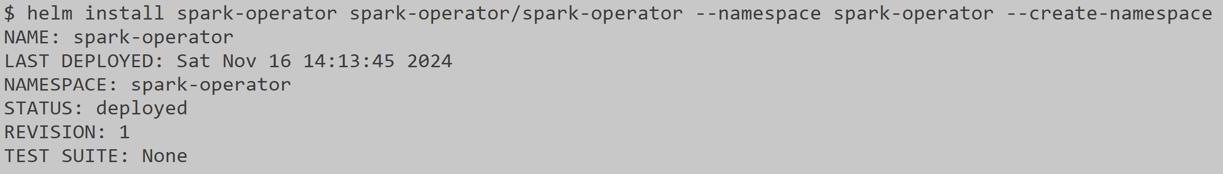
helm install
helm install spark-operator spark-operator/spark-operator \
--namespace spark-operator \
--create-namespace

Slide 45
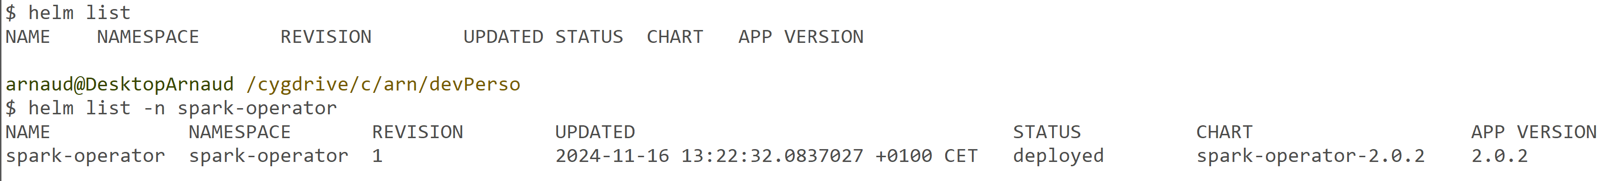
Checking: helm list
NOTICE: helm list => nothing in default namespace, need to specify "-n spark-operator"

Slide 46
installed spark-operator (2.0.2) Not Working ?

Slide 47
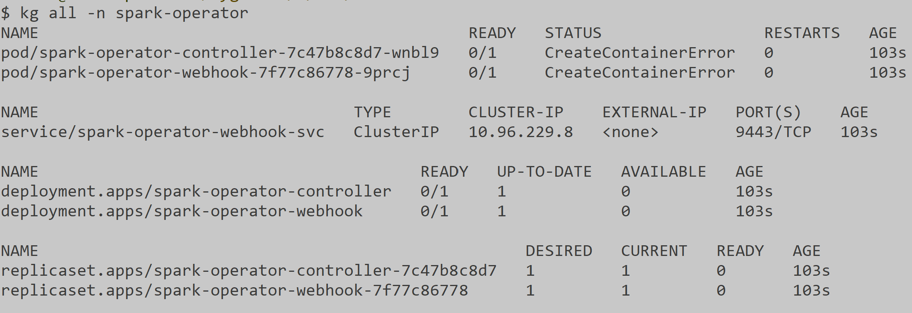
checking: kubectl get all -n spark-operator
2 errors ... CreateContainerError !

Slide 48
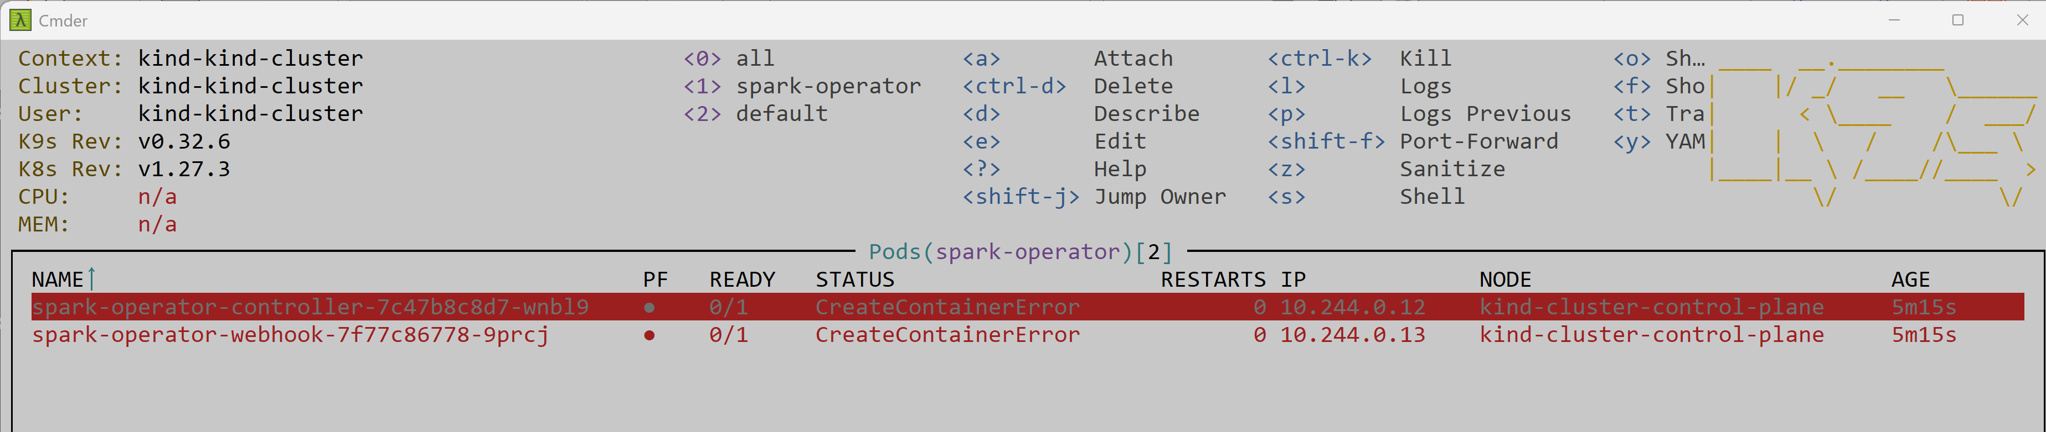
Investigating using k9s

Slide 49
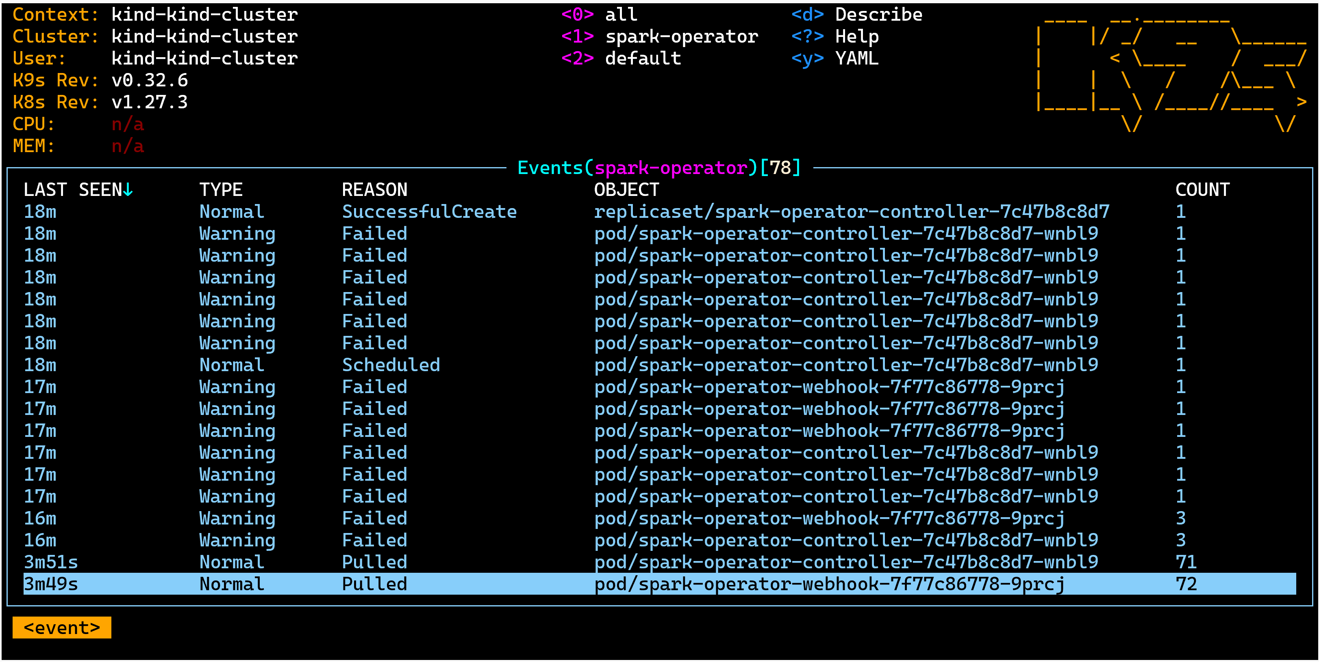
k9s events

Slide 50
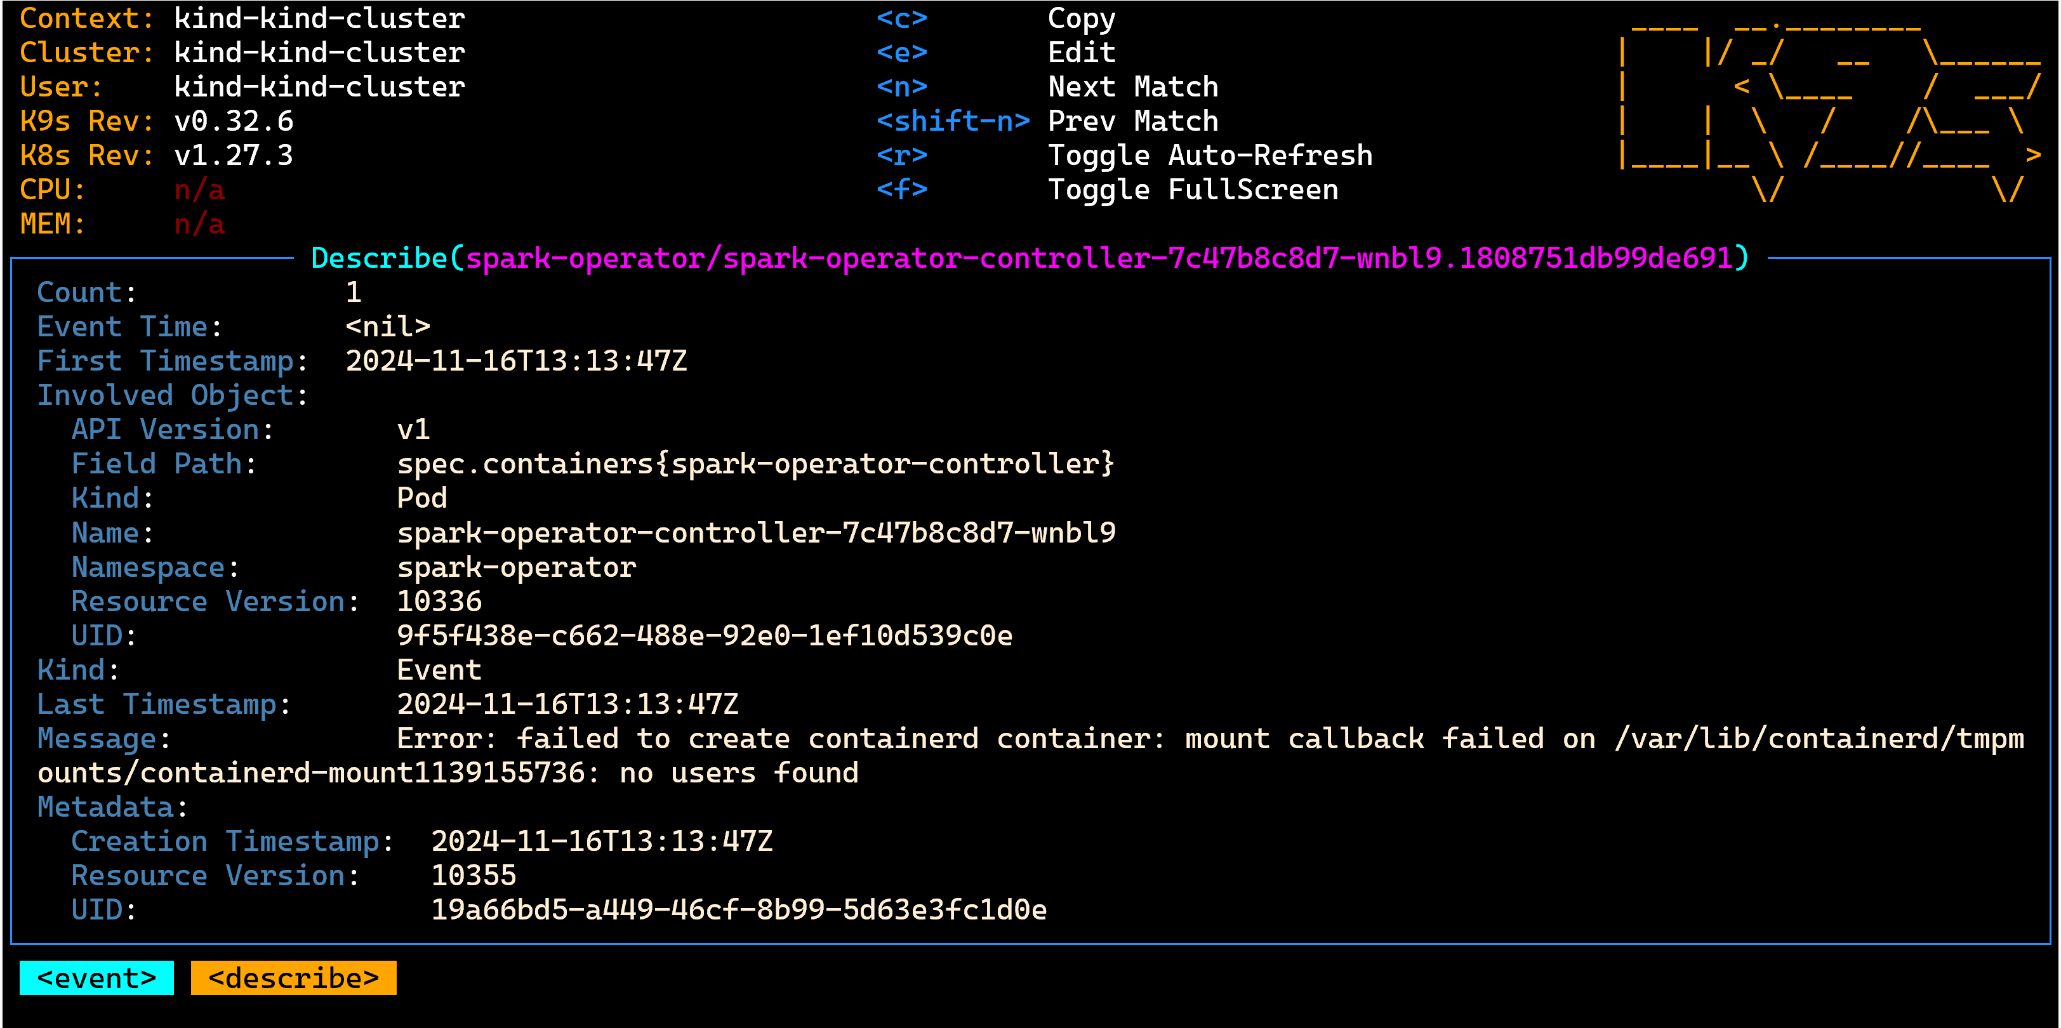
K9s - event - Failed

Slide 51
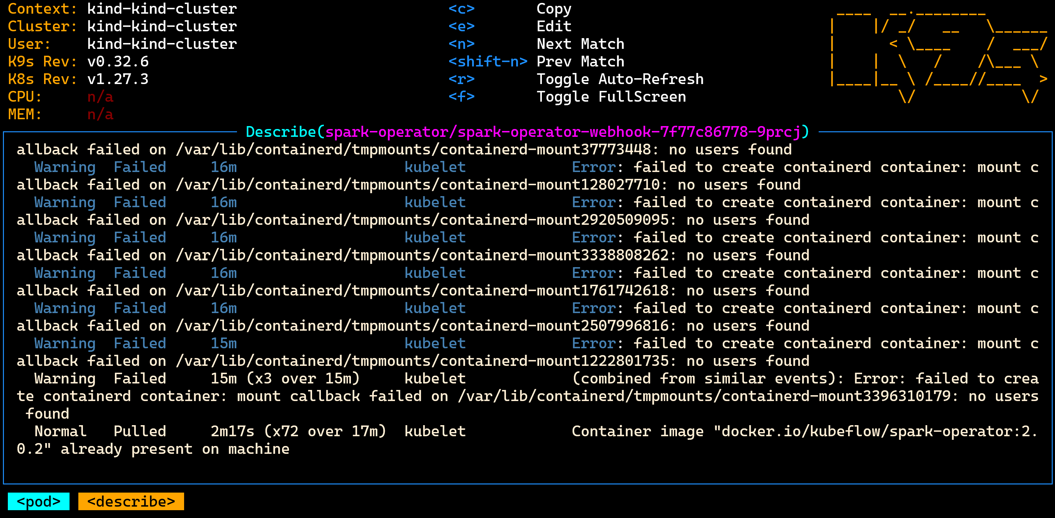
k9s - pod - describe

Slide 52

Find latest image
https://hub.docker.com/r/kubeflow/spark-operator/tags

Slide 53

k9s deployment - edit
in K9, type
( if not already set, to select namespace :
<ESCAPE> :ns<ENTER> <ESCAPE> /spark-operator <ENTER> )
<ESCAPE> :deployment <ENTER>
scroll to "spark-operator-controller" (or <ESCAPE> / *controller )
type "e" to Edit
=> your Notepad editor opens, change "2.0.2" to "latest" (or "2.1.0-rc.0" as of 2024-11)
then "SAVE" and close editor
... REPEAT same edit for other: "spark-operator-webhook"

Slide 54

deployment after edit image version
1/1 means OK... all expected "../1" are running "1/.."
Before, it was error: "0/1"

Slide 55

Check : operator pods "Running"
Pods are "Running", and Ready "1/1"
Notice also Restart=0 ( they are not in a CrashLoop causing many Restarts)

Slide 56
Finalize Installation: create ServiceAccount + role for your spark app

Slide 57

Adding serviceAccount "spark"
kubectl create serviceaccount spark
kubectl create clusterrolebinding spark-role --clusterrole=edit --serviceaccount=default:spark
--namespace=default

Slide 58

Checking ServiceAccount

Slide 59

Notice: other serviceAccounts created by "Helm" on namespace "spark-operator"

Slide 60
Next Steps: Part 2/2 open document TD5-Spark-On-k8s-part2
(Optional) Launch spark-shell on Docker, in mode "--master local[*]"
(Optional) Launch spark with "spark-submit --master k8s://localhost:port"
Launch spark with "kubectl apply -f file.yaml"
(Optional... and backup if local install fails) Using Azure Kubernetes
part 2/2

